Slide 1



Assessment of the effectiveness of VET workplace learning: VET-WL factors model.
A study in the Barcelona area
PhD. Pilar Pineda-Herrero
B.A. Anna Ciraso
B.A. Berta Espona
M.A. Carla Quesada
UAB (Autonomous University of Barcelona)
Department of Systematic and Social Pedagogy

Slide 2
1. INTRODUCTION
VET studies
Workplace
learning (WL)
An effective WL allows the students:
to complement the skills or knowledge acquired in VET developed within the institution
+
to apply their professional skills to a real work situation
+
to acquire attitudes and skills necessary for labor insertion

Slide 3
2. METHODOLOGY (I)
Goals of the project:
To describe the situation of the WL at this moment, and to identify the main practices of the WL that exist at VET institutions in Barcelona.
To capture the view of enterprises about the WL, related to: factors that determine its efficacy; its utility; their implication; and, some elements that can be improved.
To create a tool to diagnose the efficacy of WL.
To evaluate the efficacy of WL in the Barcelona area, using the factors of efficacy.
To make suggestions to promote a more effective WL that develops the skills that the job market requires.
Methodological approach of the project:
mixed, combining quantitative and qualitative data collection and data analyses;
and, non-simultaneous.
Notes:
Esta diapo la pasaría muy rápida, es mucho más general del proyecto

Slide 4
2. METHODOLOGY (II)
PHASE 1: Theoretical
review
Educational system area:
5 interviews education administrations;
1 interview high-school tutor
PHASE 2: 12 interviews with
stakeholders
Business area:
4 interviews company tutors
2 interviews Chamber de Commerce
Data analysis:
Exploratory factorial analysis
Reliability
Descriptive
Simple regressions
Multiple regressions
ANOVAs
PHASE 3:
1,026 FET-WL questionnaire for
students
(previous pilot test)
4
4
Notes:
4
Idem, explicar sobre todo la fase 3
Análisis: decir que presentamos descriptivas y regresiones múltiples. Hicimos también factorial exploratorio, ANOVAS, regresiones simples
- Professional families: "administration and management,"
“electricity and electronics", "mechanical manufacturing,"
“socio-cultural and community services" and “hotel business and tourism "
- Ownership: public, semi-public and private high-schools
- Center: specialist and generalist
- Grade: middle and upper

Slide 5
2. METHODOLOGY (III)
Variables of the interviews with
stakeholders:
Variables of the FET-WL questionnaire:
Profile
Selection of companies in the WL
Attitudes
Efficacy of WL (dependent variable)
Previous knowledge
Activity plan
Tasks
Company tutors
High-school tutors
Work environment
Reasons to participate in WL
Satisfaction
Design of WL
Implementation of training
Monitoring and relationship between
stakeholders
Evaluation of the WL
High-school tutors and coordinators of the WL
- Company tutors and coordinators of the WL
Selection of companies and students
Profile of students
Utility of the WL
Perception of satisfaction with the WL
5
5
5
Notes:
5
Profundizar en el segundo cuadro, pero también la pasaría rápido, porque no presentamos factorial

Slide 6
2. METHODOLOGY (IV)
FET-WL questionnaire:
79 items
21: student profile
multiple-choice
items
8: reasons for selecting the company
+
12: student’s attitudes
Osgood’s semantic differential scale
(5 points:1=positive; 5= negative)
+
34: variables influencing the efficacy of the WL
5-point Likert scale
(1=strongly disagree; 5= strongly agree)
+
4: efficacy of the WL
5-point Likert scale
(1=strongly disagree; 5= strongly agree)
Notes:
Explicar análisis que hemos hecho, que partimos de un factorial exploratorio (excepto en efficacia, VD)

Slide 7
3. RESULTS (I)
Attitudes
α = .918
- Social attitudes
- Individual attitudes
Variables that influence the efficacy
α = .912
- School tutor’s role
- Coherence of the high-school-company training
- Company tutor’s role, motivations
- Motivations
- Possibilities for developing the WL
- Integration into the workplace
Variables of efficacy
α = .972
- Workplace learning has allowed me to improve the knowledge and skills learnt during training
- I have been able to apply what I have learnt in my workplace learning placement
- During the workplace learning I have learnt new professional skills
- During the workplace learning I have learnt the professional skills necessary for my employability.
Notes:
Individuales: autònom/a
em sentia preparat/da
amb iniciativa
em sentia capaç
Sociales: trabajo en equipo, adaptarse al contexto de trabajo, respeto en la relación

Slide 8
3. RESULTS (II)
Profile of the students in the study:
Profile variables | Students’ distribution according to their responses
Sex | Men: 540 (47,5%) Women: 597 (52,5%)
Age | <19 years: 394 (34,7%) 19-20 years: 229 (20,2%) 20 a 22 years: 306 (27%) >22 years: 205 (18,1%)
Work experience in months | 0 months: 468 (41,5%) 0-3 months: 129 (11,4%) 3-12 months: 251 (22,2%) >12 months: 281 (24,9%)
Number of employees of the company where practices take place | <10 employees: 373 (32,9%) 10-49 employees: 431 (38%) 50-250 employees: 149 (13,1%) >250 employees: 64 (5,6%) I don’t know: 118 (10,4%)

Slide 9
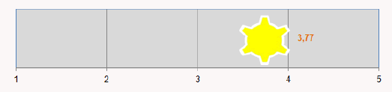
3. RESULTS (III)
Efficacy of the WL:

Slide 10
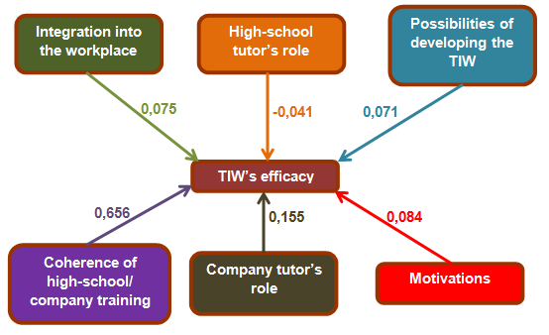
3. RESULTS (IV)
Model of WL’s efficacy:

Slide 11
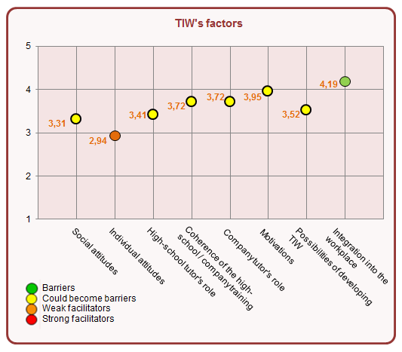
3. RESULTS (V)

Slide 12
3. RESULTS (VI)
Factors:
ATTITUDES
In the model of WL’s efficacy attitudes, individual and social, do not influence the efficacy (their importance is inhibited when there are other factors).
However, it is important to note that attitudes are higher:
at concerted high-schools than at public schools;
at upper grade than at middle grade (related to age and personal maturity as well as previous work experience);
in the case of girls when: there is more contact between tutors, they have better academic results, the academic situation is higher than the rest of the class, and they have less subjects failed;
and, when the student chooses the enterprise.
Students that have never worked evaluate more positively their individual attitudes (excessively positive perception).
HIGH-SCHOOL TUTOR’S ROLE
More appreciated by students without previous work experience (role guide).

Slide 13
3. RESULTS (VII)
COMPANY TUTOR’S ROLE
- More valued for students:
without previous work experience;
of upper grade than middle grade (type of WL);
and, students of middle and little enterprises than big companies.
MOTIVATIONS, POSSIBILITIES OF DEVELOPING WL AND INTEGRATION INTO THE WORKPLACE
More motivation the students:
without previous work experience;
and, of upper grade than middle grade (maturation, challenges at WL, next to labor insertion).
COHERENCE OF THE HIGH-SCHOOL / COMPANY TRAINING
- More valued, if:
students don’t have previous work experience;
they have changed the enterprise where they do the WL;
and, they are in a little company than if they are in a big one.

Slide 14
3. RESULTS (VI)
Efficacy:
Higher efficacy if:
students have changed company;
they are women (also in all factors except the high-school tutor’s role);
there is more contact between tutors;
they study in concerted high-schools than in public or private high-schools;
they do the WL in little companies, more than in big ones
and, if the have no failed subjects.
General results:
Best academic results, more out of practice.
To achieve a higher efficacy level it is necessary to improve: weak facilitators, specially: coherence of the high-school / company training and company tutor’s role.
High-school tutor’s role gets lower results than company tutor’s role.
Individual attitudes can act as a barrier (although they play a minor role in the efficacy).

Slide 15
4. CONCLUSIONS (I)
WL‘s evaluation results: efficacy level medium/high (3.77 on 5)
Model of WL’s efficacy:
Explained variance: 66,9%.
6 factors:
coherence of the high-school / company training;
company tutor’s role;
motivations;
integration into the workplace;
possibilities for developing the WL;
high-school tutor’s role.

Slide 16
4. CONCLUSIONS (Il)
COHERENCE OF HIGH-SCHOOL / COMPANY TRAINING
- β (factor weight)=.656**. Result: 3.41
- First item to improve in order to increase the efficacy of WL; it explains the most variance in WL’s efficacy.
COMPANY TUTOR’S ROLE
β = .155**. Result: 3.72
It is also necessary to improve it to increase the efficacy of WL.
INTEGRATION INTO THE COMPANY
β = .075**. Result: 4.19
Strong facilitator of efficacy (external factor)
INDIVIDUAL ATTITUDE
Risk of barrier for efficacy.
Low impact on efficacy, it is not a priority to improve it.
*p<0.05; **p<0.01

Slide 17
5. SOME SUGGESTIONS TO IMPROVE VET-WL
To improve the coherence of high-school / company training: contact high-school - company.
To improve the company tutor’s role: more actions to professionalize the work of company tutors and to reward their work.
To increase contact between tutors: it can bring greater coherence of higher-school / company training and integration into the workplace.
To change the evaluation system: more possible results and a more committed and continuous evaluation by both tutors.
More support during the WL to students who have lower results, introducing compensatory measures.
More attention to the coherence of high-school / company training and the company tutor’s role when the WL is done in a big company.
Notes:
Millora de la coherència de la formació de l’IES amb la FCT: contacte escola-empresa (coordinació tutors, preparació conjunta de les tasques de l’estudiant, coneixement mutu de l’escola i l’empresa...).
Millora del rol del tutor de l’empresa: accions per professionalitzar més les tasques dels tutors d’empresa i reconèixer la seva funció (model de referència per l’alumnat i agent clau per a la seva integració a l’empresa). Més formació, relació entre tutors, incentius, organització de trobades, obtenció de certificats... No oblidant el seu caràcter moltes vegades altruista.
Sistema d’avaluació amb més rangs que apte/no apte i una avaluació més compromesa i continua per part dels dos tutors. Més opcions de qualificació pot augmentar la motivació de l’alumnat i requeriria més coordinació entre tutors, però augmentaria la coherència de la formació IES amb la FCT i, per tant, l’eficàcia de la FCT.

Slide 18
THANK YOU
pilar.pineda@uab.es
anna.ciraso@uab.es

