Slide 1
CAREER-PATHING IN THE NEW TYRE CHAMBER
Presented to:

Slide 2
Overview
Understanding the problem
Ladders, Lattices and Paths
Proposed Methodology
Project Outputs

Slide 3
Understanding the Research Problem
Need for Career-Pathing in production related occupations in the New Tyre Chamber
Agreement on that but “Career-Pathing” will mean different things based on perspective

Slide 4
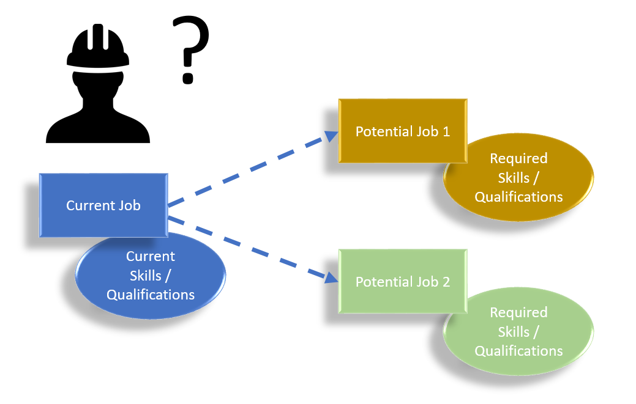
Understanding the Research Problem
Employee Perspective
Need a Skills Audit

Slide 5
Understanding the Research Problem
Employer / Sector Perspective
Need a Mapping Process

Slide 6
Understanding the Research Problem
The purpose of this concept note / presentation is to unpack the two perspectives and propose a methodological way forward.

Slide 7
Ladders, Lattices and Paths
Employee’s Perspective
Which job would I like to progress into?
What are the skills and / or qualifications that are required to perform in that role?
What skills and / or qualifications do I have?
Identify the development that I would need in order to close the gap so that I would be a suitable candidate for that role.

Slide 8
Ladders, Lattices and Paths
Employee’s Perspective
Limited to the defined paths available
Manager
Team Leader
Technician
Machine Operator
General Worker

Slide 9
Ladders, Lattices and Paths
Employee’s Perspective
It would be more desirable to have more options from which to plan

Slide 10
Ladders, Lattices and Paths
Therefore, it is proposed that the mapping process is done prior to a sector / chamber skills audit so that the outcomes of the skills audit will lead to more comprehensive career paths for the employees

Slide 11
Ladders, Lattices and Paths
Career Lattice

Slide 12
Ladders, Lattices and Paths
Career Lattice
Joanne Cleaver (2012) as a diagonal framework that braids lateral experiences, adjacent skill acquisition, and peer networking to move employees to any of a variety of positions for which they have become qualified
Move sideways or even down in order to move up
HBR: Career path is a zigzag instead of straight up

Slide 13
Ladders, Lattices and Paths
Career Lattice
Employees can look for additional responsibilities or learning in an adjacent role
Allows for alternative career options to move diagonally
Look at alternative paths into occupations with skills gaps
Pipeline for priority skills
Encourages and environment of multi-skilling

Slide 14
Ladders, Lattices and Paths
Level
Glass Ceiling
A
B
C
D
Technical or Operational Stream
Career Ladders
Possible Career Lattices

Slide 15
Ladders, Lattices and Paths
Career Lattice
If we understand the common elements between jobs (in stream A and B for example), a skills audit can extend beyond a person’s current role
This is not to be confused with assessments for qualifications (RPL trade tests etc). Instead, it is a means of articulating the skills requirements in a job that allows for employees to have more options in terms of personal career development

Slide 16
Proposed Methodology
Phase 1: Capture Job Profiles
Base Technical Skills Requirements. This (and the specialist skills) may include a formal qualification, license and or experience.
Specialist Technical Skills Requirements.
Non-Technical Skills Requirements
Company Specific Requirements
This is an example of a competency framework. The final competency framework may differ.

Slide 17
Proposed Methodology
Phase 2: Establish Common Language
OFO
Common jobs titles within OFO Occupations

Slide 18
Proposed Methodology
Phase 3: Map Overlapping Roles
Phase 4: Career Pathing Tool

Slide 19
Project Outputs
The project will produce two core outputs:
1. Catalogue of production jobs in the New Tyre Chamber. The jobs will be mapped to the OFO (which will make WSP submissions easier and more reliable) and articulated based on a common language.
2. A prototype of the Career Pathing Tool will be developed as a proof of concept. It will not be a final ‘consumer ready’ tool but rather a simple application of the principle to demonstrate the feasibility of a more structured roll out.

Slide 20
Conclusion and Way forward
Mapping Process First
Followed by Skills Audit
If the current proposed project defines the map, the skills audit marks: “You are here”

Slide 21
Questions?

