Slide 1
Prof. Dr. Dr. h.c. Felix Rauner
Memorandum on Innovative Apprenticeship
Report of the INAP Commission
24 April 2013, University of Witwatersrand
Johannesburg, South Africa
Notes:
1

Slide 2

During the Board Meeting of the 4th INAP conference
in Beijing 2011, it has been decided to set up a
working commission on Innovative Apprenticeship Architecture.
This Group consists of following members:
Prof. Felix Rauner (chair) Germany
Prof. Salim Akoojee South Africa
Prof. Robert I. Lerman United States
Prof. Erica Smith Australia
Dr. Bonita Watt-Malcolm Canada
Helmut Zelloth European Training Foundation
Prof. Zhiqun Zhao China
Prof. Dr. Dr. h.c. Felix Rauner

Slide 3
Central questions:
How can the coordination between the vocational education and training systems and employment systems be improved?
What are the conditions for promoting employment opportunities for young people, thus facilitating the transition from school to work?
What are the effects on the competitiveness of companies?
How can rewarding careers be made accessible for a large segment of
the population?
Prof. Dr. Dr. h.c. Felix Rauner

Slide 4
Memorandum
‘An Architecture for Modern Apprenticeships’
– Standards for Structure, Organisation and Governance –
The International Network on Innovative Apprenticeship
CONTENT
Chapter 1: Criteria for modern dual vocational education and training including
the establishment of a stable and reliable dual VET track
Chapter 2: Standards and governance for dual VET systems
Chapter 3: Structure and development of occupational curricula
Prof. Dr. Dr. h.c. Felix Rauner

Slide 5
I. Criteria for modern dual vocational education and training including
the establishment of a stable and reliable dual VET track
High quality and holistic competence in an occupational field
Competence to shape one’s work – shaping competence’, ability to independently control and manage one’s professional tasks
Seeing ‘work context’ as a constitutive feature of professional work
The concept of ‘core occupations’ reduces the horizontal and vertical division of labour
Creating sustainable occupational profiles
Open dynamic occupational profiles
Prof. Dr. Dr. h.c. Felix Rauner

Slide 6
I. Criteria for modern dual vocational education and training including
the establishment of a stable and reliable dual VET track
Promoting occupational identity
Desirable time scale for learning to be competent in an
occupation
Need for continuing professional development
Cooperation between learning venues
The legal status of apprentices
Cost-benefit of in-company apprenticeship training
Occupational domains and vocational disciplines
Integration of vocational education into a higher education
structure parallel track
Prof. Dr. Dr. h.c. Felix Rauner

Slide 7
II. Governance of Dual VET Systems
Consistent legal framework
Cooperation of actors
Allocation of strategic and operative functions
4. Innovation strategies
Prof. Dr. Dr. h.c. Felix Rauner

Slide 8
II. Governance of Dual VET Systems
Consistent legal framework
Cooperation of actors
Allocation of strategic and operative functions
4. Innovation strategies
III. Structure and development of occupational curricula
The Curriculum
Methods of Curriculum Development
Prof. Dr. Dr. h.c. Felix Rauner

Slide 9
Learning by doing vs. Innovative Apprenticeship
 | Low potential work-based training | Innovative Apprenticeship
1. Occupations | fragmented, specialized, company oriented, Taylorist (up to some thousands) | open dynamic (European) core occupations (between 250 and 300)
2. Duration | 2 years and less | 3 to 4 years including the option: occupational baccalaureate)
3. Competence | fragmented, modularized, know that-based | occupational shaping competence: reflected holistic problem solving (reflected professionals)
4. Knowledge | narrow know that-knowledge | work process knowledge: as a holistic and shaping oriented knowledge
Prof. Dr. Dr. h.c. Felix Rauner

Slide 10
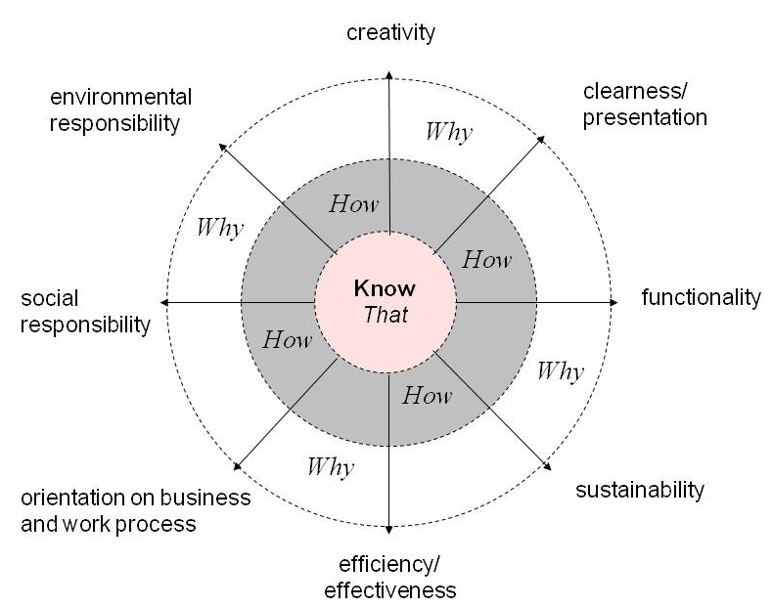
Prof. Dr. Dr. h.c. Felix Rauner

Slide 11
Low potential work-based training | Innovative Apprenticeship
5. Work Experience | unreflected work experience (learning by doing): rigid and constrained work attitude and behaviour | reflected and systematised work experience
6. Duality of Learning | separate learning venues: training approach | integrated and co-operative learning venues: enabling for (co) shaping the world of work and society in social, economic and ecological responsibility
7. Apprenticeship as part of a dual track VET system | isolated training approach | Apprenticeship as a first step in a dual education and training track up to dual master programs (professional) level
Prof. Dr. Dr. h.c. Felix Rauner

Slide 12
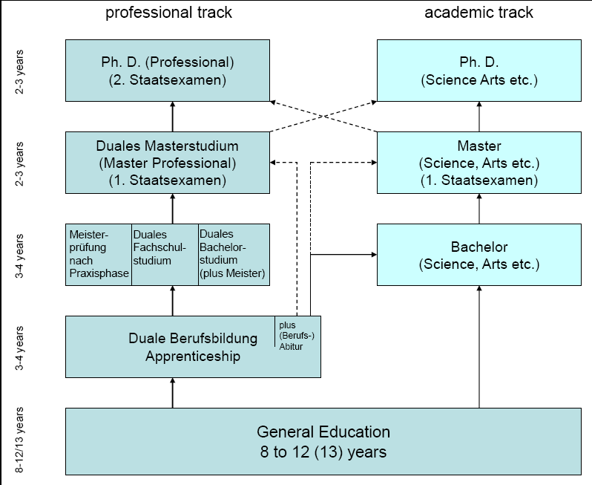
Architecture Apprenticeship
Prof. Dr. Dr. h.c. Felix Rauner

Slide 13
8. Governance | fragmented governance | integrated governance approach: Consistent legal framework Cooperation of Actors/Institutions Allocation of teaching and operative functions Innovative strategies
9. Levels of Qualifications | 6 to 10 Hierarchical structure Risk: Deskilling | Three levels Skilled workers Master craftsman (industry)/Bachelor (professional) Dual Master Programmes: Master (professional)
10. Attractiveness | very low (stigmatisation) risks: low wages, unemployment, social disintegration, low vocational identity and commitment | highly attractive occupational pathway, high potential for occupational identity and occupational commitment
Prof. Dr. Dr. h.c. Felix Rauner

Slide 14
Inputs and Perspectives
from different countries
(South Africa, Australia, China, Indonesia and the United States)
Discussion

