Slide 1
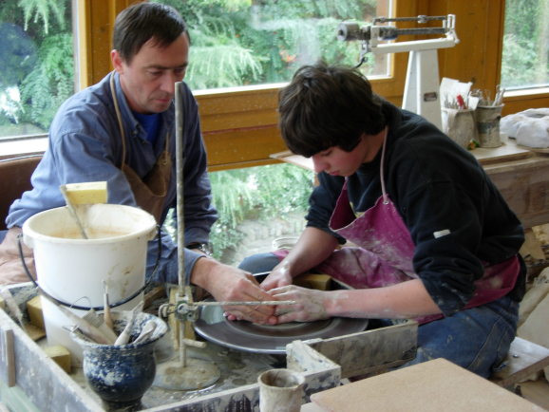
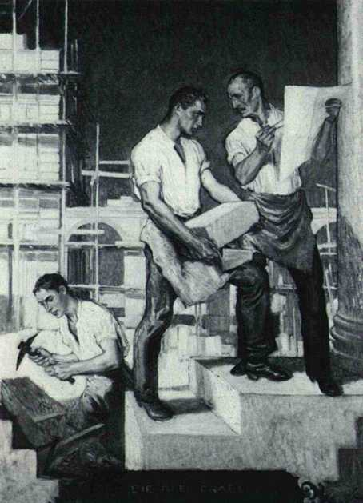
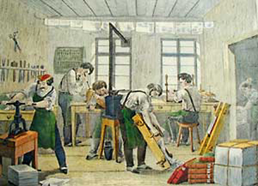
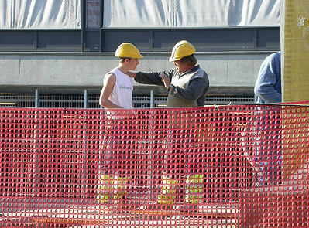
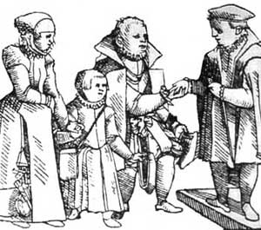
„Between a rock and a hard place“
Structural dilemmas of workplace trainers
in German apprenticeship training
Anke Bahl (Federal Institute for Vocational Education and Training)
INAP Conference Johannesburg, 23.04.2013
Notes:
Das Projekt „…“, dass wir Ihnen hier vorstellen möchten, beschäftigt sich mit der Frage, welche Formen der Qualifikationsbedarfsdeckung sich in wachsenden Beschäftigungsfeldern entwickeln und ob sich diese von jenen in herkömmlichen Beschäftigungsfeldern unterscheiden. Thema sind Rekrutierungsvorgänge und Personalentwicklungsstrategien sowie auch die Vorstellungen der UN zur Art der Qualifizierung.

Slide 2
company-based training staff as a huge and vague target group
Who belongs to this group?
formally registered and responsible trainers (Ausbilder) of the training companies in 2010: 675.198 persons [BBB 2012]
In 1998 16 % of the economically active population, i.e. 5,8 million employees across all sectors regularly fulfilled training responsibilities in apprenticeship schemes.
[Erwerbstätigenbefragung 1998/99]
Of this group again:
  6 % were employed as full-time trainers.
  14 % reported to be owners of the company.
  80 % reported to be „temporarily“ involved in training and provided it as a sideline.
  94 % of all employees involved in apprenticeship training are „part-time trainers“
[Erwerbstätigenbefragung 1991/92; Bausch 1997]
  The latter can also be classified as „informal workplace educators“ or “hidden protagonists of workplace learning”. [Ostendorf 2012]
  The trainer as a person is difficult to conceptualise. The training function is shared by several categories of employees → cf. concept of „community of practice“
[Lave/Wenger 1991]

Slide 3
research question and approach
What are relevant factors / decisive parameters for the professional development and support of training staff involved in apprenticeship?
Qualitative approach based on case studies focusing the company setting as a whole:
→ semi-structured interviews with employees belonging to the following groups:
        HR managers / heads of training departments / owners
        full-time and part-time trainers
        line managers
        employee representatives
        apprentices / trainees
      in training companies varying with regard to
        size
        sector / branch
        region
        training occupations offered

Slide 4
Sample of case studies in 14 companies a total of 127 Interviews
Large companies / corporate groups:
Power and Electrical Engineering - 8600 Empl.- 107 Appr. in D. 15
Insurance Business - 5500 Empl. – 230 Appr. 15
Vehicle and Engine Construction - Location with 1500 Empl. – 120 Appr. 3
Medium companies:
Facility Management (Cleaning)– 1000 Empl. – 4 Appr. 6
Chemical Industry – 850 Empl. –151 Appr. 12
Tool Making – Location with 680 Empl. – 64 Appr. 15
Drive Systems and Components – Location with 192 Empl. – 19 Appr. 4
Information Technology – 500 Empl. – 24 Appr. 10
Small companies:
Hotel and Catering Trade – 90 Empl. – 11 Appr. 12
Building – 50 Empl. – 4 Appr. 10
Health (Dental Laboratory) – 29 Empl. – 5 Appr. 13
Electrician and Sanitary Trade – 25 Empl. – 6 Azb. 6
Butcher Shop with Home Slaughtering – 34 Empl. – 1 Appr. 5
Motor Vehicle Trade – 6 Empl. – 1 Appr. 1

Slide 5
features of the training task in apprenticeship
dilemmas due to its position at the threshold between the education and the employment system
  Workplace trainers: challenge to fulfil both profit-oriented and educational tasks
  → goal (and time) conflicts
  Formally designated trainers need to respond to
  - interests of the state (§ Vocational Training Act; § Trainer Aptitude Regulation)
  - interests of the company
  - interests of the apprentices
  → conflicting role expectations
  Trainers are dependent employees and at the same time employers to the apprentices
  → leads to a high pressure to act and be successful in training
    → „institutional weakness“ [Pätzold 1986]; „ambivalent and precarious status“ [Schlösser, Drewes, Osthues 1989], „invisibility“ [SIAP]
    → lack of industrial lobby; committee members traditionally take sides with apprentices

Slide 6
Specific intermediary position of training staff
"You are always caught between a rock and a hard place. You have obligations to management, of course. You also have obligations to the apprentices, to the workers' councils and to the parents. You need to remain very balanced and keep a clear head when approaching things. […] This involves considerable personality skills, […] like a politician, […] to ensure that everyone is happy to some extent."
[Former Head of Initial and Continuing Training at a major metalworking company]
"The trainers are mostly the main (and only) point of contact for the trainees. They also accept the direct responsibility which results from this. If the trainers are unable to assist further, there are usually direct negative consequences for the trainees, which are also directly felt by the trainers. This leads to the compulsion of "having to act", even if company structures do not allow for this and trainers frequently find themselves acting outside their actual field of activity and responsibility and thus compensating for weaknesses in the company structures."
[Written statement made by the Head of Initial and Continuing Training at another major metalworking company]
Notes:
Increased productivity and profitability requirements in companies are pressurising trainers to prove their legitimacy and are calling their role into question.
The example of the IT branch
The principle of principle of rechargeability means that costs of training can be directly broken down to the level of the trainers themselves. The consequence in this case is that the task of the trainer is abolished and replaced by the role of the "mentor". Result: the trainees are left to their own devices.

Slide 7
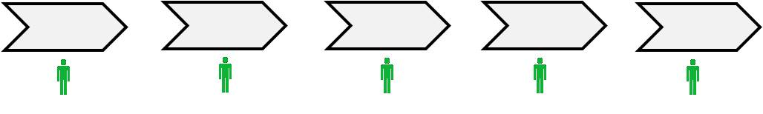
Large Company of the Services Sector with Branches
Insurance Group (5500 Empl.)
VD
Vertriebsdirektion (VD)
Agentur







Head Office
IVET management


Agentur

VD
Vertriebsdirektion (VD)






Agentur

VD
VD








= training manager
= part-time trainer

Slide 8
Aspect "Autonomy of part-time trainers at the workplace" - 1
"No, I am broadly given a free hand by my Head of Department, who trusts me and believes that things are being run properly on the basis of the positive feedback provided by the trainees. Examination results are good, and this means that there is no reason why I should be given wider stipulations or different stipulations. […] And I also find it good that he gives me a relatively free hand and that he does not influence my work in terms of the way in which I do it."
"Yes, it's incredibly time-consuming to offer trainees a reasonable level of support alongside the normal routine work I have to do. I arrived at the following consideration. I wanted to move in a single direction, either normal work or training. In our Life Insurance Department at [name of group], however, THERE WAS NO job which simply involved training."
[Administrator and workplace trainer in "Life insurance" at the Head Office of an insurance group]
Notes:
Trainers value their autonomy
Training provides a welcome change to the rest of the daily routine, direct feedback from trainees
Helps towards job satisfaction

Slide 9
Aspect "Autonomy of part-time trainers at the workplace" - 2
"And I was the first trainer here in [location] to look after several trainees. I was, of course, also under observation from my Head of the Department, the workers' council and the Human Resources Department. The feedback from the trainees was, however, very positive. They enjoyed working in a team and also enjoyed the fact that the trainer was able to give them plenty of time. This system was then also adopted for health insurance six or nine months later."
[Administrator and workplace trainer in "Life insurance" at the Head Office of an insurance group]
"What do you need to bring to the table in order to be a trainer? … Who does the recruitment, the nature of the selection process, the methods used, which test is done – in fact the whole of the selection procedure is pre-stipulated. Such matters are laid down. The things in between, however, training in daily life, in the department, in the [sales office], within the division, involve creative individual decision making. To this extent, we cannot influence the process. And we do not seek to do so. We have no desire to meddle. We prefer to approach the topics in a convincing way."
[Head of Training at an insurance group]
Notes:
Trainers value their autonomy
Training provides a welcome change to the rest of the daily routine, direct feedback from trainees
Helps towards job satisfaction

Slide 10
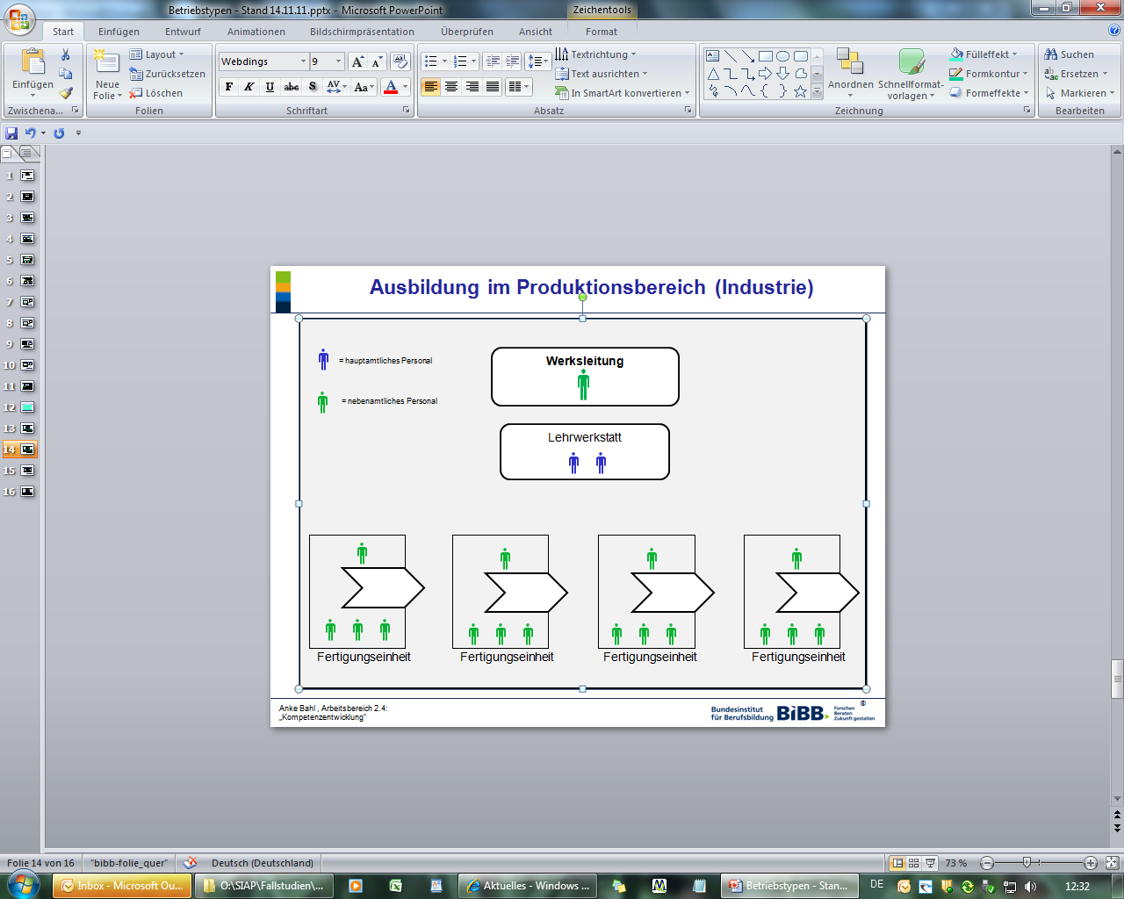

Large Company of the Manufacturing Industry
Power and Electrical Engineering (8600 Empl.)
Head office / Main location
Location B
Location C

Commercial Training, dual study courses
Technical Training;
Workshop


= training manager

= full-time trainer
LocationA

= part-time trainer

Slide 11
Aspect "Defending the importance of the role in technical industry"
"We need to say quite clearly that we have a skill and that this skill earns the money. We should be viewed as indirect staff, i.e. my activity does not actually earn money for our group. This means that I give priority to production if there is a production plant."
[Part-time trainer at an SME manufacturer in the electrical branch, now under US ownership]
"Most divisions see training as being very important. They are pleased to get well trained people, but most divisions do not actually wish to have anything to do with training itself. (- -) I am accepted at a personal level. I do not have any problems with colleagues. No one has yet come to me and constantly said: 'I have to share my money with you, I have to earn for you.' Because we do not earn any money in this sense, we're not productive, (laughs quietly) are we? […] There is, therefore, no malice or anything like that, but, as I said, they see training as important and useful, but (-) the thing is that no one actually wants to do the work."
[Full-time trainer. Metalworking apprenticeship workshop, SME metalworking company]
Notes:
Dominance of the image of creating value via PRODUCTION
Increased productivity and profitability requirements in companies are pressurising trainers to prove their legitimacy and are calling their role into question.

Slide 12
Industrial Training in the Production Sector
Vehicle and Engine Construction, appr. 1500 Employees


Head of initial and continuous training
= training manager

CVET
= full-time
trainer
Koordinator
Ausbildungsmeister (alternierend) Produktionsinsel
Full-time trainers (with Meister qualification)
in training workshop (permanent)

Weiterbildung









= part-time trainer/
informal workplace trainer
LKW-Montage
Mechanik
Logistik



Ausbildungskoordinator
Ausbildungskoordinator
Ausbildungskoordinator
Ausbildungsbeauftragte (=Meister)
Ausbildungsbeauftragte (=Meister)
Ausbildungsbeauftragte (=Meister)















Ausbildungsbegleiter
Informal workplace trainers
Informal workplace trainers





…





…






Slide 13
Example of an active strategy within the organisation as a whole
"It was a major task to make the full-time trainers [at the training workshop] aware of the fact that we are producing something here, namely skilled workers. We produce skilled workers. We do not do this to amuse ourselves or because it is such an enjoyable thing to do. […] We do it because the company wants to have these skilled workers. And the company has a right to obtain good, the best skilled workers. And if we do not succeed, it is equally possible that the company will tell us: 'Listen here. You're not doing things properly. We no longer want your skilled workers! […] Simple words, but everyone knows what they mean. And then we started […] to prepare recipes for how to establish training within the company processes. […]
And over the last two or three years, we have succeeded, I believe, […] in increasingly convincing company management just what an important building block training is. The demographic realisations now gained have also, of course, favoured this. But I could already tell that cooperation was a back and forth process, a matter of give and take. We were now not merely small-scale trainers who had to come and beg, there were also demands placed upon us: 'Listen, we've got so-and-so, can we not prepare a few people?’”
[Former Head of Initial and Continuing Training at a major German metalworking company]
Notes:
Active use of the image of production
Danger of outsourcing of training or of the cessation of training entirely
Increased productivity and profitability requirements in companies are pressurising trainers to prove their legitimacy and are calling their role into question.
Economies/reduction to core business etc.

Slide 14
Corporate Group Services Sector
Information Technology (appr. 500 Empl.)
Börsennotierte Holding AG


= Training
Manager




= part-time trainer
GmbH
Tochtergesellschaft
AG
Tochtergesellschaft
GmbH
Tochtergesellschaft
AG
Tochtergesellschaft










Slide 15
Aspect "Powerless training manager in a segmented structure"
"And the sole reason for this is not the fact that, […] that there is no money – we have no budget, my budget has run out, I no longer have any budget for initial training. It's also due to the fact that this restructuring has brought about […] such a rift that central support both in human resources development and in training is unbelievably arduous.
As a small cog in the wheel – actually I am only a simple member of staff – I should march into every management board and say: 'How many trainees would you like to have in the company for next year? How much money am I allowed to spend on placing an advertisement for you?' Of course, I then make relevant proposals. […] 'May I attend a trade fair? If yes, how much can it cost?' etc. So, I think, the greatest expenditure of time I have, or the largest part of my work, is to provide information and decisions. And that doesn't work."
[Head of Training in a holding structure/IT branch]

Slide 16
Aspect "Remuneration model"
"And the trainees we have are ultimately also seen as a cheap source of labour, but unlike before, unlike the way things really used to be, no resources are invested, neither in terms of human resources nor financial, are they? […] For example, the trainers at [subsidiary X] get a bonus if they can recharge time, invoice the customers for working time. This means that training time, i.e. time spent by a trainer with his trainees, is not rechargeable. The result is that members of staff automatically reduce their bonus if they [spend] time with trainees."
[Head of Training at an IT group]
Notes:
Increased productivity and profitability requirements in companies are pressurising trainers to prove their legitimacy and are calling their role into question.
The example of the IT branch
The principle of principle of rechargeability means that costs of training can be directly broken down to the level of the trainers themselves. The consequence in this case is that the task of the trainer is abolished and replaced by the role of the "mentor". Result: the trainees are left to their own devices.

Slide 17
Delegation of training responsibility to employee level
"(sighs) (- - -) I have to think back to the person with whom I negotiated that a day would be made available to me. The company was still young at the time, and I had the feeling that it supported the whole thing. (-) Given everything that has happened in the meantime, I honestly have to say that I have blocked out all thoughts of all the people who were my line managers. /Yes./ I can now only just about remember the last few. /Okay./ I KNOW that we had a meeting a few years ago, during which I said: 'We have to bring a bit of structure to the whole affair'. I developed a concept for this, and this was also requested: 'If you want to do this, then present to me a concept of how you would like to provide training here in the company.' /Yes./ So, this was requested here in the department, and I was given time to prepare it. /By your line manager?/ By my line manager, yes. (-) (groans quietly) (- - -) "
[Former part-time trainer in the IT branch (software programming)]
Notes:
Increased productivity and profitability requirements in companies are pressurising trainers to prove their legitimacy and are calling their role into question.
The example of the IT branch
The principle of principle of rechargeability means that costs of training can be directly broken down to the level of the trainers themselves. The consequence in this case is that the task of the trainer is abolished and replaced by the role of the "mentor". Result: the trainees are left to their own devices.

Slide 18
Issues for Discussion
While apprentices are visible, the trainers behind them are not. There is a lack of official recognition for their contribution to the training process.
Global processes of commodification and reorganisation such as outsourcing and segmentation increase the structural pressures in-company trainers face and threaten the traditional role of workplace trainers in apprenticeship training. Most of the trainers interviewed were poorly prepared to do anything about this trend.
The general call for professionalisation of VET personnel in German and European policy does not adequately respond to the particular situation of workplace trainers. The continuous comparison of their function with VET teachers is misleading.
Promoting competence frameworks entails the risk of masking the actual potential of facilitation processes provided by the majority of informal workplace trainers and of inadvertently pushing the general tendency of outsourcing the training function altogether.
Focusing on trainers as individual agents obstructs the view of the organisational challenges and realities of training provision in an economic setting.
Learning in the workplace needs to be promoted as a concept that entails more than insular situations of instruction but requires a supportive and comprehensive strategy for the organisation as a whole.
Professional development of workplace trainers requires as a starting point the systematic reflection of their role within the respective company context. Strengthened awareness and self-esteem in their role as learning facilitators are prerequisites for the development of personal strategies to negotiate their contradictory demands.
Notes:
Die – zunehmend mit Frauen besetzte – Ausbildungsleitung hat als schwächstes Glied der PE-Abteilung und aufgrund dessen organisatorischer Ansiedelung jenseits der Linienorganisation so gut wie keine offizielle Handhabe und ist daher umso mehr auf persönliche Bindungen und Kontakte im Unternehmen angewiesen.

Slide 19
Thank you for listening and for any kind of feedback!
  Contakt:
  Anke Bahl
  Federal Institute for Vocational Education and Training
  Robert-Schuman-Platz 3
  D-53175 Bonn
  bahl@bibb.de
  +49-(0)228-107-1407
  Further information and the research report can be found here:
  http://www.kibb.de/wlk51765.htm

Slide 20

Ausdifferenzierung der Zielgruppe „ausbildendes Personal“

Ausbildungsleiter/-in
Planungs- und Management-Ebene, Administration

Hauptberufliche/-r Ausbilder/-in in Lehrwerkstätten / Lehrlaboren
Planungs- und Umsetzungsebene, Administration

Nebenberufliche/-r Ausbilder/-in
Fachausbilder/-in / Ausbildungsbeauftragte/-r
Umsetzungsebene



Ausbildende Fachkraft
Umsetzungsebene

Slide 21
Klein- und Kleinstbetrieb im Handwerk
KFZ-Werkstatt (6 MA)
Überbetriebliches Bildungszentrum




Ausbildender = Inhaber





= hauptberufliches Personal
= nebenberuflicher Ausbilder/-in /Inhaber

= nebenberuflich
ausbildende Fachkraft

Slide 22
KMU Handwerksbetrieb
Elektro/Sanitär-Heizung-Klima (25 MA)
Überbetriebliches Bildungszentrum







Kundendienst
(Service, Wartung)
Projekte
Baustelle






= nebenberuflicher Ausbilder/Inhaber


= hauptberufliches Personal


= nebenberuflich
ausbildende Fachkraft

Slide 23
KMU mit Service-Ausbilder-Unterstützung
Mittelständisches Metallunternehmen/IHK ohne eigene Lehrwerkstatt (192 MA)
Bildungszentrum
Ausbildender = Geschäftsführer









= hauptberufliches Personal
= nebenberuflicher Ausbilder/-in

= nebenberuflich
ausbildende Fachkraft

Slide 24
KMU mit Service-Ausbilder-Unterstützung
Mittelständisches Metallunternehmen/IHK ohne eigene Lehrwerkstatt (192 MA)
Bildungszentrum
Ausbildender = Geschäftsführer









= hauptberufliches Personal
= nebenberuflicher Ausbilder/-in

= nebenberuflich
ausbildende Fachkraft

Slide 25
KMU Baugewerbe
Mittelständ. Bauunternehmen Rohrleitungsbau (50 MA)
Überbetriebliches Bildungszentrum

= hauptberufliches Personal








= nebenberuflich
ausbildende Fachkraft

= Ausbildungsleiterin/
Ehefrau des Inhabers
Baustelle
Baustelle
Baustelle
Baustelle





















Slide 26
Industrie-Bildungsdienstleister / Outgesourcte Ausbildung
Dienstleister Chemiepark (230/850 MA)
GmbH
Bildungszentrum
Produktion
Infrastruktur
Bereich
Personal










Tochterunternehmen
Partner-UN
Externe Unternehmen

= Ausbildungsleitung










= hauptberufliches Personal

= nebenberufliches Personal
. . .
. . .
. . .

