Slide 1
Successful educational outcomes after early apprenticeship contract terminations: The effect of learning experiences
INAP Johannesburg April 2013
Dr. Barbara E. Stalder
Institut Sekundarstufe II
Notes:
Media Center, 2. OG

Slide 2
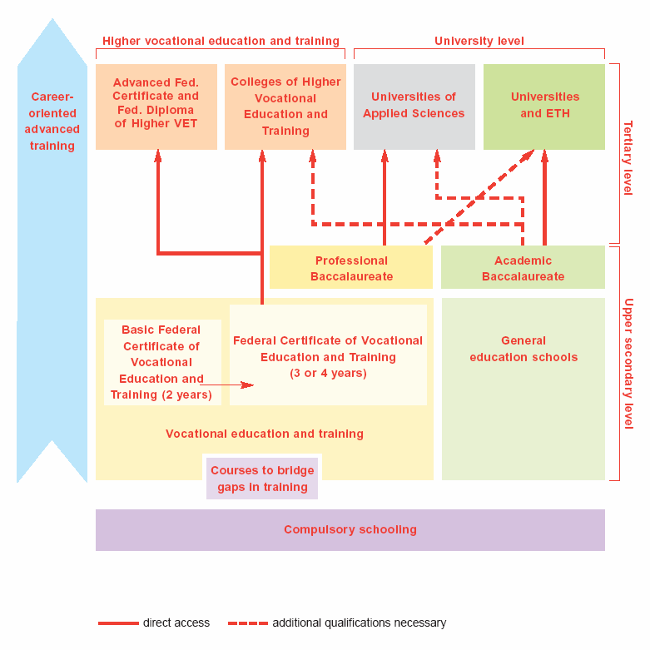
Swiss Educational System
Compulsory School and Upper Secondary education
Upper secondary education
Vocational education and training:
2 to 4+ years
General education programmes:
3 to 4 years
Responsibility of Federal government, cantons and prof. organisations
Compulsory school
9 years; age 6-15;
primary school
(years 1-4/6)
lower secondary
(years 5/7-9)
up to four different tracks
Responsibility of cantons and communes
VET in Switzerland - Brisbane 2008
2
Notes:
Characteristics of the Swiss education system
As a whole, the characteristics for the educational and political system are:
federalism (sovereignty of the cantons)
decentralisation (importance of the responsibilities of the cantons and municipalities)
the subsidiarity of the state measures (i.e. the principle is that superior levels such as the Confederation or cantons can only pass regulations or undertake tasks where the subordinate levels are not in a position to do so),
and the semi-direct democracy (national referendum, ballot initiatives, referendums).
2

Slide 3
Swiss Educational System
Upper Secondary education
29‘000 students
in general education programs
80‘000 students in VET-programmes
89% apprenticeship
11% full-time VET-school
250 occupations
VET in Switzerland - Brisbane 2008
3
Notes:
Characteristics of the Swiss education system
As a whole, the characteristics for the educational and political system are:
federalism (sovereignty of the cantons)
decentralisation (importance of the responsibilities of the cantons and municipalities)
the subsidiarity of the state measures (i.e. the principle is that superior levels such as the Confederation or cantons can only pass regulations or undertake tasks where the subordinate levels are not in a position to do so),
and the semi-direct democracy (national referendum, ballot initiatives, referendums).
3

Slide 4

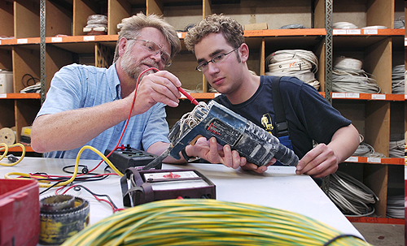


Apprenticeship: “dual” VET
„DUAL“ means
Shared responsibilities to establish VET in different occupations
  National and regional governments, professional organisations and social partners
Shared task to educate and train apprentices and to prepare them for the final exams
  Training companies, vocational colleges, cross-company courses
Shared costs
  Training companies, national and regional government, apprentices
☺☺☺ Shared responsibility, success and benefit
Notes:
Abschlüsse 2006 (BFS, Website)
Gymnasiale Maturitätszeugnisse 16'948
Berufsmaturitätszeugnisse 10'602
Lehrpatente 207
Eidg. Fähigkeitszeugnisse EFZ 51'860
Eidg. Berufsatteste EBA 99
Andere Fähigkeitszeugnisse 2'172
Handelsmittelschuldiplome 2'706
Fachmittelschulabschlüsse 2'933
Anlehrausweise 2'598

Slide 5
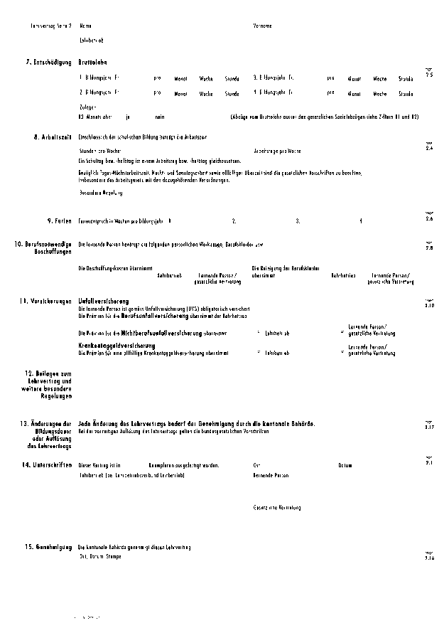
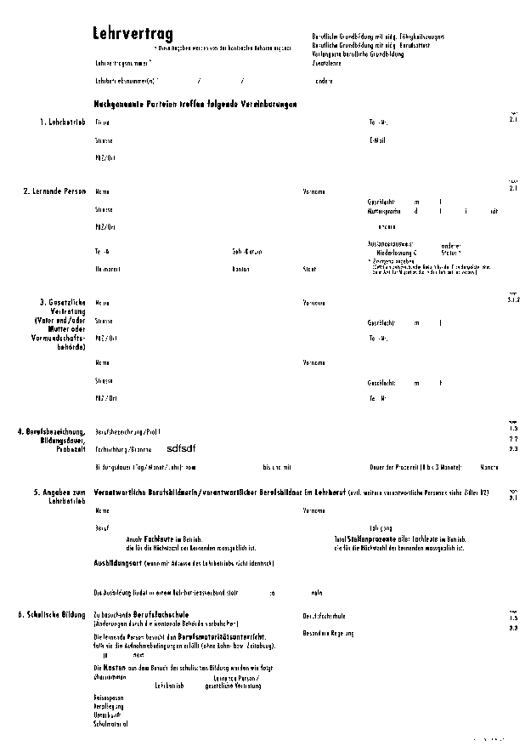
Apprenticeship contract
Contract partners:
company and apprentice
(and parents if apprentices are under 18)
Special work contract, limited duration
Regulates
- occupation and certificate/diploma,
- duration of training,
- probation period,
- apprentice’s salary, sharing of costs
- working hours
Only contract partners can decide on early termination
Cantonal administration has to approve contract and its early termination
Vocational college teachers can advise on cancellation or change of contract

Slide 6
Apprenticeship contract
Contract partners:
company and apprentice
(and parents if apprentices are under 18)
Special work contract, limited duration
Regulates
- occupation and certificate/diploma,
- duration of training,
- probation period,
- apprentice’s salary, sharing of costs
- working hours
Only contract partners can decide on early termination
Cantonal administration has to approve contract and its early termination
Vocational college teachers can advise on cancellation or change of contract
20% or more contracts are terminated early

Slide 7
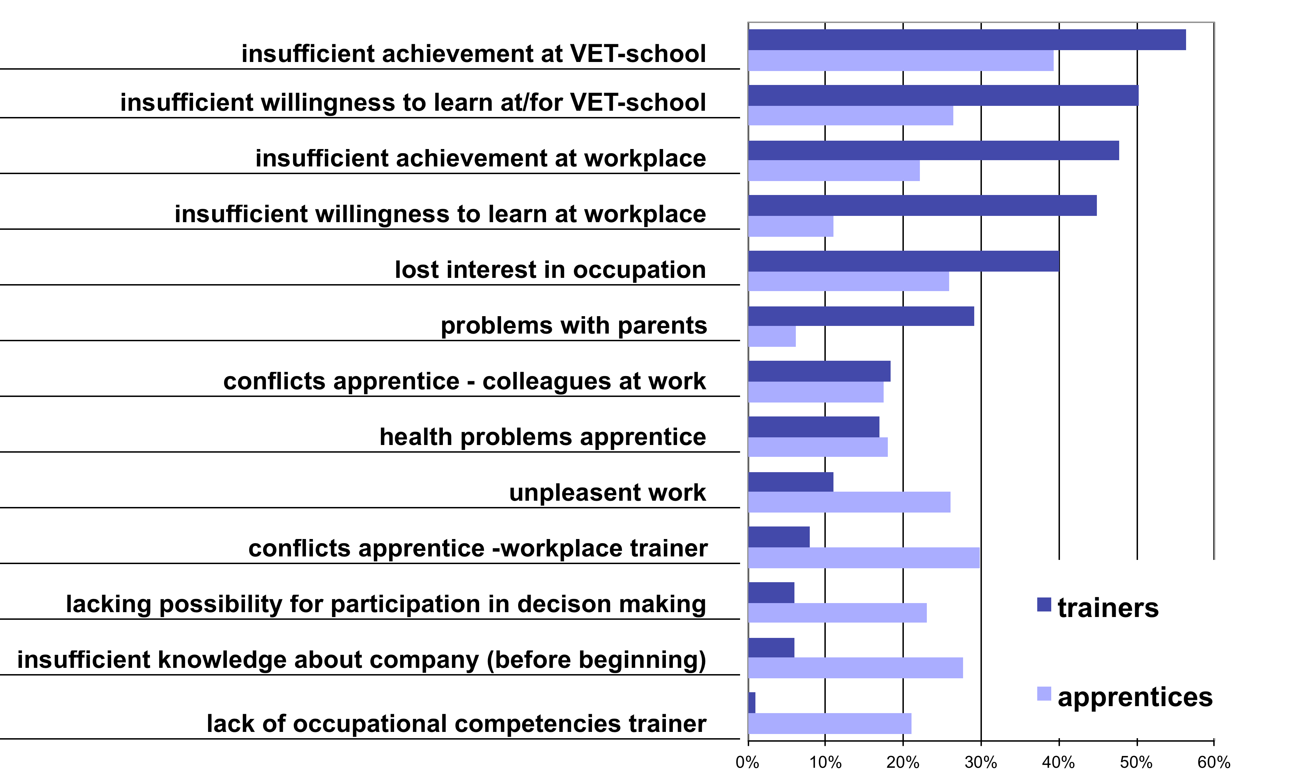
Reasons for early contract termination
Source: Steder&Schmid, 2006; Data LEVA
N_{L}=1289
N_{B}=1205

Slide 8
Early terminations of apprenticeship contracts some drop out, others change to new VET
 | %
TOTAL % of apprentices with early termination | 28.6
1. Re-entry shortly after early termination | 20.8
1.1 downgrading and class repetition | 10.9
1.2 changing occupational field | 2.9
1.3 changing training company | 7.0
2. DROPOUT without immediate re-entry | 7.8
TOTAL % of apprentices with linear pathway | 71.4
Stalder, 2012; Data TREE, N=2098, weighted analyses

Slide 9
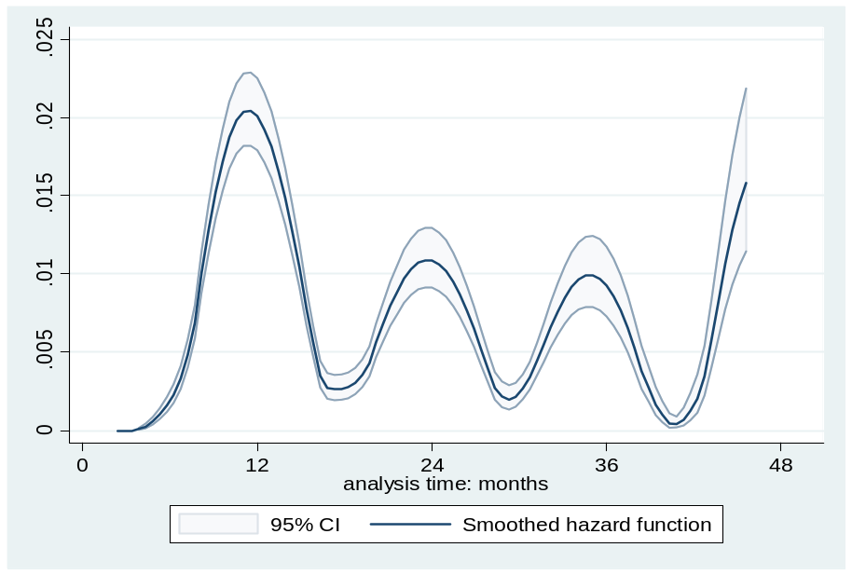
Timing of early contract termination
Rate of change and dropout (smoothed hazard-function)
Early termination most likely at the end of first, and to some extent after second, third and fourth year; in between less likely (~ conditional probabilities)

Slide 10
Who re-enters VET again?
Factors influencing the chance for immediate re-entry after the early termination:
Educational pathway before early termination
Timing of termination
Reasons for the termination
Social support received in finding a new training place
Factors influencing the chance for re-entry some time later:
Educational and work activities shortly after the contract termination
Readiness to re-engage in vocational choice
(Schmid&Stalder, 2008; Stalder, 2012)

Slide 11
Learning experiences
Positive learning experiences: ample learning possibilities, interesting tasks, supportive and competent teachers and trainers
-> increase
self-efficacy expectations, outcome expectations and interests
motivation to learn, educational satisfaction and commitment
job-related competencies
-> decrease
risk for educational dropout
(Cart & Trelcat, 2010; Karmel & Mlotkowski, 2010; Lent, 2002; Rauner, 2009; Stalder, 2012; Vazsonyi & Snider, 2008)
Notes:
Outcome expectation bei Lent: Das Gefühl, dass eine bestimmte Ausbildung zu einem positiven Ergebnis führt (z.B. Zufriedenheit im Beruf)

Slide 12
Research questions
1. How do educational and work activities in the first month after the early termination affect later educational outcomes?
2. How do learning experiences before the early contract terminations contribute to successful later educational outcomes?
Specification:
Learning experiences at the workplace
Learning experiences at the vocational school

Slide 13
The study
LEVA: 1392 apprentices and their employers after early contracts termination
Female: 42%, male: 58%
Longitudinal study with 4 waves.
Wave 1 (2004):
immediately after contract termination
Written survey apprentices
Wave 2 (2005):
Written survey apprentices
Wave 3 (2007):
CATI and written survey apprentices
Wave 4 (2012):
CATI and written survey apprentices
Wave 1 (2004):
Written survey employers
Data used: Apprentices wave 1 and 3, N=902

Slide 14
The measures
Wave | Construct | Items
1 | Educational and work activities | a) VET programme b) bridging course c) employment without training contract d) NEET (not in education, employment or training)
1 | Learning experiences at the workplace | At work, I could learn a lot of new things My apprenticeship trainer was good at explaining things | 8 items; α=.88
1 | Learning experiences at vocational school | At school, I could learn a lot of new things My main teacher was good at explaining things | 5 items; α=.84
3 | Successful educational outcome | Having obtained a VET-diploma or being in VET 30 months after the early terminaion
1 | Control variables: Sociodemographics, reasons for termination | Gender, migration background, reasons for early terminatiion: personal, insufficient VET school achievement

Slide 15
Descriptive results
Educational and work activities 1 month after termination | %
Had re-entered VET | 48%
Bridging course | 9%
Employment without training contract | 15%
NEET | 29%
Learning experiences
Workplace Mean: 3.3 (SD=.93), scale 1-5
School Mean: 3.8 (SD=.84), scale 1-5

Slide 16
Predictors of successful educational outcome thirty months after contract termination
PREDICTORS | expB | p
Educational and work activities
[VET-programme]
Bridging course | .106 | *** risk 9 times higher
Employment without training contract | .035 | *** risk 28 times higher
NEET | .060 | *** risk 17 times higher
Learning experience before contract termination
At vocational school | 1.262 | *
At workplace | .834
Control variables: Gender, Migration background, reasons for early termination
Nagelkerke R²=.38; *: p<.05, **: p<.01, ***: p<.001
Notes:
9.433962264
28.57142857
16.66666667

Slide 17
Results
Strong effect of educational/work activities immediately after contract termination
Successful educational outcomes most likely for those, who had re-entered VET shortly after the early apprenticeship contract termination.
NEETs with more successful outcomes than those who were employed without an apprenticeship contract.
Positive effect of learning experiences at VET-school
positive learning experiences at school predicted successful outcomes above and beyond educational and work activities in the first month after the termination.
No effect of learning experiences at the work place.

Slide 18
Discussion
Positive experiences at vocational school
-> encourage re-entry and foster later obtainment of VET-diploma
Positive experience at the workplace
-> is not linked to specific outcome: all is possible: re-entry in VET, employment without training contract, bridging course, unemployment.
Supporting re-entry and later obtainment of upper secondary diploma:
- foster positive learning experience at VET schools
- raise awareness among employers and employees
- create tailor-made re-entry programmes for adults
- promote validation of work experience (validation des acquis)
- plan future educational career before before early termination
- promote use of career guidance at an early stage
Notes:
Ntiles
Schule Unterstes Quartil 41% mit Abschluss oder noch drin, 13% erwerb ohne abschluss
Schule Oberstes Quartil 66% ; 8%
Betrieb Unterstes Quartil 61%; 9%
Betrieb Oberstes Quartil 60%; 9%
Mulitnomial: weder schule noch betrieb hat einfluss auf erwerb ohne abschluss im vgl zu anderem (brüc, neet etc.)
Was bleibt ist schule erhöht chance auf abschluss im vgl zu anderem

