Slide 1

To what extent do facets of the learning environment influence apprentices‘ motivation and learning success?
Annalisa Schnitzler
(German Federal Institute for Vocational Education and Training)
Johannesburg, 23 April 2013

Slide 2
Outline
  Theoretical Background
  Excursus: 2 venues of training in German VET
  Why intrinsic motivation and how to improve it?
  Research project
  Study design and sample
  Variables assessed to predict intrinsic motivation
  Results
    Working/Learning environment and motivation
    Prediction of apprentices’ intrinsic motivation
INAP Conference, Annalisa Schnitzler

Slide 3
German dual system of Vocational Education and Training
Vocational school and the company providing training fulfill a joint educational remit
1-2 days/ week
4 days/ week
Vocational School
Training Company
Teaches vocational and general educational content, specialist competence and general skills
Enables pupils to carry out occupational tasks
Provides opportunities for learning via acting and for applying the domain specific contents learned at school in practice
Enables apprentices to acquire the ability to perform professionally on their own
INAP Conference, Annalisa Schnitzler

Slide 4
Why intrinsic motivation?
What is intrinsic motivation?
„internal“ motivation, governed by individual interests, not external encouragement
„Intrinsically motivated behaviors are performed out of interest and thus require no specific contingencies“ (like threats or promises) (Deci & Ryan 2000)
Why do we need intrinsic motivation?
i
Intrinsic motivation indispensable for succesful learning and for engaging more thoroughly in learning (Deci & Ryan 2000)
Intrinsic motivation as a mediator between the learner’s personality, the learning environment and competence development (Franke 2005)
-> particularly in informal learning contexts, where learning takes place mainly incidentally and without rewards
INAP Conference, Annalisa Schnitzler

Slide 5
Development of motivation
Willingness to learn and work diligently
Workplace design
Motivation achievable not through selected learning opportunities, but through a continuous beneficial working environment
Competence development
INAP Conference, Annalisa Schnitzler

Slide 6
How to improve intrinsic motivation?
Frieling et al. (2006): To identifiy a working environment that stimulates learning, features of work tasks as well as aspects of the social environment have to be considered
Hackman/Oldham (1975) – Job-Characteristics-Model: conditions enhancing motivation while attending to one‘s tasks:
Experienced responsibility for work outcomes (autonomy)
Experienced meaningfulness of work
Knowledge of results of work activities
Deci & Ryan (2000):
Autonomy-supportive events enhance intrinsic motivation
Activities providing an optimal challenge enhance intrinsic motivation
Under autonomy-supportive conditions, feedback (especially positive feedback) enhances intrinsic motivation
INAP Conference, Annalisa Schnitzler

Slide 7
How to improve intrinsic motivation?
Beicht et al. (2009): Tasks designed with these principles in mind can only develop their positive effect on motivation and competence, if they are embedded in a positive working/ learning atmosphere (mutual support, respectful interactions with colleagues)
Dreyfus & Dreyfus (1980): Watching experts doing and explaining their work enables novices to recognize patterns in their work
Lave & Wenger (1991): “Acceptance by and interaction with acknowledged adept practicioners make learning legitimate and of value from the point of view of the apprentice.”
INAP Conference, Annalisa Schnitzler

Slide 8
Study design
Project cooperation of BIBB and University of Stuttgart
Aim of the project: Studying the relationships between input (e.g. prior knowledge), variables of the training process (e.g. motivation and quality of training) and output (e.g. domain-specific knowledge)
Prior domain
specific knowledge
General
mental abilities
(CFT 20R)
Domain specific
knowledge
Basic mathematical
skills
Training quality in
vocational school
and company
Training quality in
vocational school
and company
Basic reading
comprehension
Motivation
Motivation
Cohort 1
1st year of training
2nd year of training
Jan 2011
Jan 2012
Intermediate exam
Dez 2012
INAP Conference, Annalisa Schnitzler

Slide 9
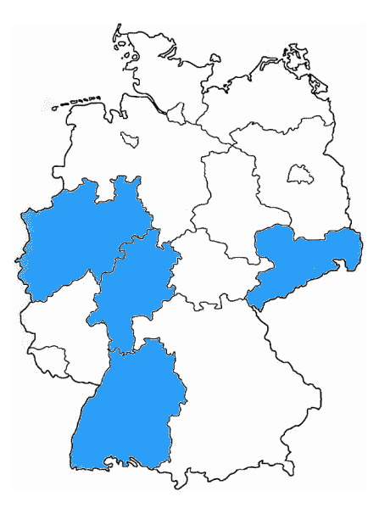
Study sample and variables
Sample
Prospective mechatronics fitters in their first year of training (N=579) from 4 German federal states,
aged 18,5 years, male-dominated profession
Type of schooling | % of sample
Basic secondary schooling | 3,1
Intermediate secondary schooling | 70,5
Upper secondary schooling | 25,9
Assessed dependent variable
Apprentices‘ intrinsic motivation for doing work at the training company (following Prenzel et al. 1996)
➔ 3 Items, e.g. „Working at the training company was real fun.“
Cronbach‘s Alpha α=.83/.82 (based on partial sample)
INAP Conference, Annalisa Schnitzler

Slide 10
Variables - Predictors
Assessed dimensions of company-based training
(IBAQ – Velten & Schnitzler 2012)
Work tasks (task variety & matching of job demands to apprentice‘s skills) (6 Items) (α=.81)¹
Meaningfulness of tasks (3 Items) (α=.78)
Autonomy (3 Items) (α=.77)
Feedback (5 Items) (α=.79)
Excessive demands in form of time pressure (4 Items) (α=.72)
Trainer‘s professional competence (8 Items) (α=.87)
Trainer‘s personal involvement (4 Items) (α=.82)
Colleagues‘ behavior (6 Items) (α=.87)
I’m given tasks that match my skills
My team relies on the results of my work
My trainer cares for my well-being
My colleagues explain their thoughts while working on a problem
¹ (Cronbach‘s Alpha based on partial sample)
INAP Conference, Annalisa Schnitzler

Slide 11
Results: Working environment and motivation
Mechatronics fitters ½ year into training
Motivation-relevant facets of working/ learning environment | Intrinsic Motivation (N=579)
Work task diversity and complexity | .465**
Autonomy | .336**
Meaningfulness | .311**
Feedback | .367**
Excessive demands | -.379**
Trainer‘s competence | .484**
Trainer‘s involvement | .457**
Colleagues‘ behavior | .406**
Note: ** The beta-coefficient is significant at the .01 level.
INAP Conference, Annalisa Schnitzler

Slide 12
Prediction of apprentices‘ motivation (Multiple Regression)
Mechatronics fitters ½ year into training (N=579)
Predictors | B | SE | Β | R² |  |  |  | R² adj.
1. Work task diversity and complexity | .214 | .053 | .170**
Excessive demands | -.200 | .043 | -.171**
Autonomy | .084 | .031 | .101**
Feedback | .015 | .042 | .016
Meaningfulness | .052 | .033 | .062 | .338 |  |  |  | .332
Colleagues‘ behavior | .187 | .039 | .178**
Trainers’s competence | .123 | .049 | .125*
Trainer‘s involvement | .095 | .043 | .112* | .387 |  |  |  | .378
Note: ** The beta-coefficient is significant at the .01 level. * The beta-coefficient is significant at the .05 level.
Work task diversity and complexity and excessive demands on the one hand and colleagues‘ and trainer‘s support on the other hand predict a substantial amount of apprentices‘ intrinsic motivation.
INAP Conference, Annalisa Schnitzler

Slide 13
Prediction of apprentices‘ motivation after 1 year (Mult. Reg.)
Mechatronics fitters midtraining – N=479
Predictors | B | SE | β | R² | R² adj.
1. Work task diversity and complexity | .226 | .063 | .172**
Excessive demands | -.157 | .057 | -.131** | .083 | .079
2. Trainer‘s involvement | .085 | .043 | .098* | .090 | .085
Note: ** The beta-coefficient is significant at the .01 level. * The beta-coefficient is significant at the .05 level.
Work task diversity and complexity, excessive demands and to a lesser extent the trainer‘s involvement contribute to apprentices‘ motivation even a whole year later.
INAP Conference, Annalisa Schnitzler

Slide 14
Summary
☞
Influence of working/ learning environment on motivation
Working/learning environment has a strong impact on apprentices’ intrinsic motivation to do their tasks in the training company.
Especially task design, in the form of varied tasks that match the respective apprentice’s skills, substantially affects intrinsic motivation.
Not only trainer’s competence and involvement influence intrinsic motivation, but also other colleagues’ support and willingness to give the apprentice access to their expert performance.
Not surprisingly, motivation is influenced most strongly by immediate training quality; however, some facets of the working environment affect motivation even over a period of one year.
INAP Conference, Annalisa Schnitzler

Slide 15
Outlook
◻
Working environment , motivation and learning success
The working environment facets of excessive demands and meaningfulness have a small but significant effect on domain specific knowledge at mid-training (R²=.05).
Adding the apprentices’ intrinsic motivation to the impact of the environment facets, R² increases to 7.4%.
To be continued…
Motivation
Prior knowledge
Domain specific competence
Mental abilities
Basic skills
Vocational school
Training company
INAP Conference, Annalisa Schnitzler

Slide 16

Thank you for your attention!
Annalisa Schnitzler
German Federal Institute for Vocational Education and Training
Section 2.4 - Skills and Competence Development
schnitzler@bibb.de
www.bibb.de/aquakom

Slide 17
References
Beicht, U., Krewerth, A., Eberhard, V. & Granato, M. 2009, Viel Licht - aber auch Schatten: Qualität dualer Berufsausbildung in Deutschland aus Sicht der Auszubildenden, URL: http://www.bibb.de/dokumente/pdf/a12_bibbreport_2009_09.pdf, retrieved January 17, 2013
Deci, E. & Ryan, R. 2000, What is the Self in Self-Directed Learning? Findings from recent motivational Research. In: Straka, G. (Ed.), Conceptions of self-directed learning: theoretical and conceptional considerations. Münster: Waxmann, 75-92.
Dreyfus, S. E.& Dreyfus, H.L. 1980, A five-stage model of the mental activities involved in directed skill acquisition. University of California, Berkeley: Operations Research Center, URL: http://www.dtic.mil/cgi-bin/GetTRDoc?AD=ADA084551&Location=U2&doc=GetTRDoc.pdf, retrieved January 17, 2013.
Hackman, J. R. & Oldham, G. R.1975, Development of the Job Diagnostic Survey, Journal of Applied Psychology, 60, 159-170.
Franke, G. 2005, Facetten der Kompetenzentwicklung. Bielefeld: Bertelsmann.
Frieling, E., Bernard, H., Bigalk, D. & Müller, R. F. 2006, Lernen durch Arbeit - Entwicklung eines Verfahrens zur Bestimmung der Lernmöglichkeiten am Arbeitsplatz. Münster: Waxmann
Lave, J.& Wenger, E. 1991, Situated learning: Legitimate peripheral participation. Cambridge: Cambridge University Press.
Prenzel, M., Kristen, A., Dengler, P., Ettle, R., & Beer, T. 1996, Selbstbestimmt motiviertes und interessiertes Lernen in der kaufmännischen Erstausbildung. In: Beck, K. & Heid, H. (Ed.), Lehr- Lern- Prozesse in der kaufmännischen Erstausbildung – Wissenserwerb, Motivierungsgeschehen und Handlungskompetenzen, Beiheft 13 zur Zeitschrift für Berufs- und Wirtschaftspädagogik. Stuttgart: Steiner, 109-127.
Velten, S. & Schnitzler, A. 2012, Inventar zur betrieblichen Ausbildungsqualität (IBAQ), Zeitschrift für Berufs- und Wirtschaftspädagogik, 108, 511-527.

Slide 18
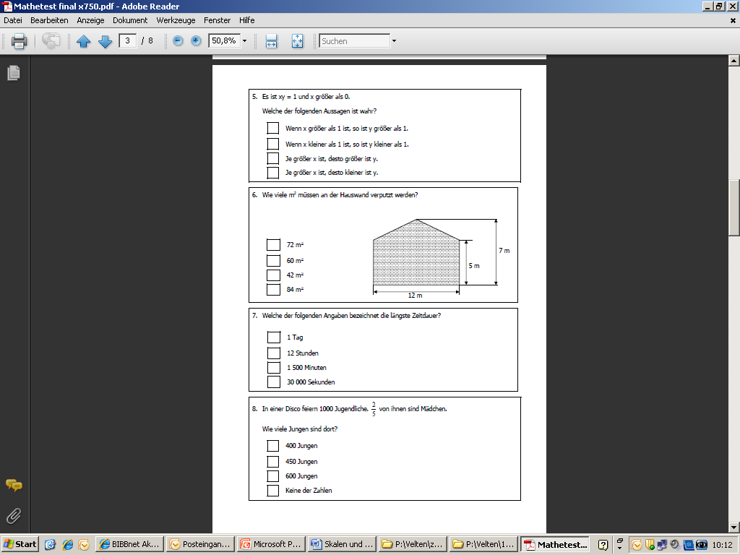
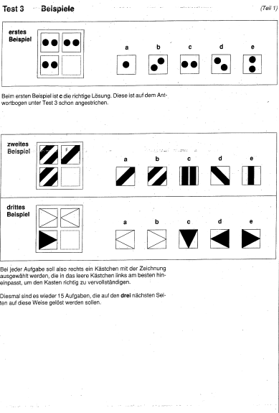
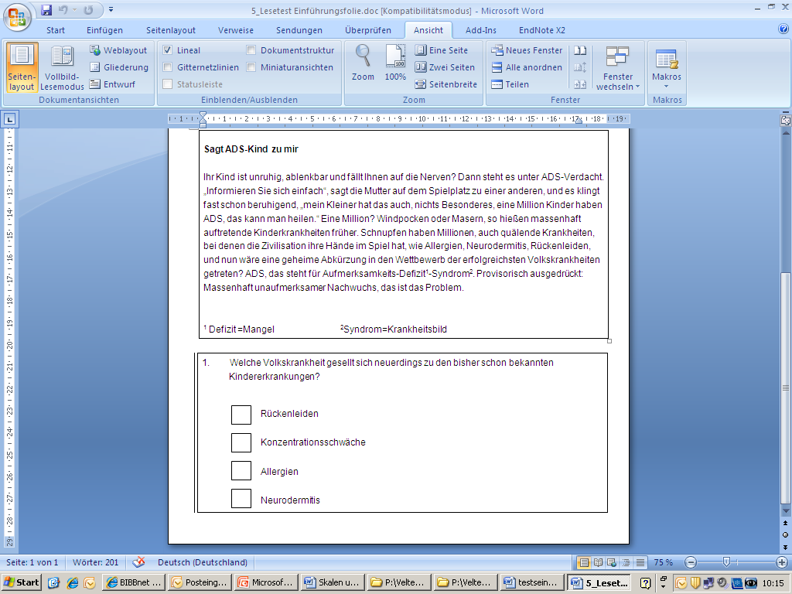
Backup: Instruments – Basic competences and skills
Initial (cognitive) resources
Mathematical skills
Reading comprehension
General mental abilities (reasoning)

Slide 19
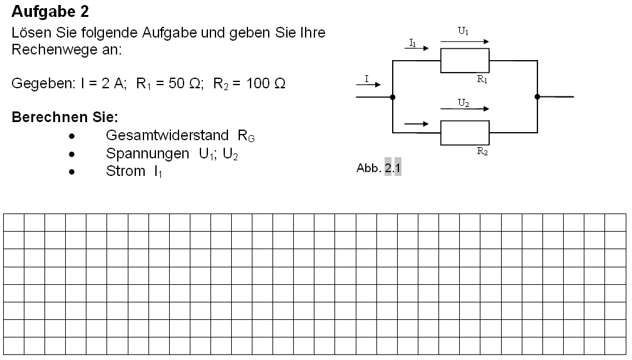
Backup: domain specific knowledge

