Slide 1
Linking Informal apprenticeship and formal education in South-eastern Nigeria through market/mechanic village schools
Benjamin A. Ogwo, Ph.D
State University of New York,
Oswego, NY 13126, USA
A Paper Presented to INAP Conference in cooperation with ILO Skills and Employability Department, on April 23, 2013 held in Johannesburg, South Africa

Slide 2
Linking Informal apprenticeship and formal education in South-eastern Nigeria through Market & Mechanic Village School (MMVS)
Objective
highlight the process, nature, and scope of the Market & Mechanic Village Schools (MMVS) intervention on linking informal apprenticeship and formal education in South-eastern Nigeria.
Sequence
Context and Historical Reasons for the MMVS
The ETF MMVS Intervention Process (R & D)
Features of the UNICEF and the Redesigned MMVS Curricula
Overview of the ICT Component of the MMVS
Prospects of MMVS in South Eastern Nigeria
Conclusions and Closing Thoughts

Slide 3
Context and Historical Reasons for the Market Mechanic Village Schools
Why the Market/Mechanic Schools
and the Linkage Intervention?
1
2
3
4
People of South
Eastern, Nigeria
Origin of Market
Mechanic Schools
Reason for Market
Mechanic School
Intervention
Scope of the
intervention
UNICEF initiative (1996)
Provision of basic
literacy for the apprentices
Combine work & school
thrice per week(12 – 2 pm)
Improved
curricula
ICT integration
Certification
Patriarchal society
(Male dominance)
Achievement
Oriented
Low enrolment
Low repute
No certificate

Slide 4



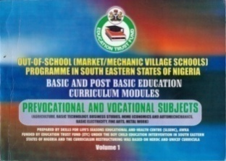
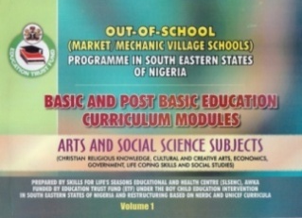
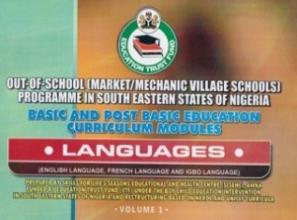

The Market/Mechanic Village Schools Intervention Process (R & D)
Level 1: Survey on increased male enrolment in informal Apprenticeship
Level 2: Study tour to India (NIOS) & Don Bosco Tech.
Level 3: Study to Botswana (BOCODOL) & Bridge centre
Level 4: Stakeholders’ Interactive Forums and the Curricular outputs
Notes:
Keywords:
filtering, 4 levels, four levels

Slide 5
Features of the UNICEF and the Redesigned Market/Mechanic Village School Curricula
UNICEF out-of-school Curriculum
Basic Literacy subjects: Mathematics, English and Life coping skills
Classes are held thrice a week (12 – 2 pm)
No certification
Highlights of MMVS Redesigned curricula
Thematic restructuring of the two existing basic education curricula and UNICEF curriculum into one flexible (lower and middle basic curricula) curriculum to be completed in three years
Thematic restructuring of the existing Upper Basic and secondary school curriculum into a more flexible two-year programme.
Introduction of Life coping skills from the UNICEF out-of-school curriculum as a new basic education subject: The subject entails ethics, Information Communication Technology, Health and Physical Education etc
Market School students will be sitting for the same certification examination with every other equivalent level students in the country.
Current National Standard Curricula
Nine years Compulsory basic Education
- Three years (lower, middle & upper
  Basic curricular)
Three year Secondary Education
Classes are held five days a week
(8:00 am – 2:00 pm)
Certification (First School Leaving Cert.
& General Certificate of Education)

Slide 6
Features of the Redesigned Market/Mechanic Village School Curricula contd:
ICT Delivery mode and open learning principles
Introduction of ICT-based interactive tutors that will supplement face-to-face instruction and ensure more flexible curriculum implementation.
Dynamic-profiled intelligent tutors for the Market/Mechanic Village School that provide immediate feedback and remedial measures in the course of a particular lesson.
The Market/Mechanic Village School tutor redirects learners to appropriate content without explicitly allowing feedback on poor performance to discourage them from completing the lesson.

Slide 7
Overview of the ICT Component of the Market/Mechanic Village School
Sample of the Learning Object (LO) for a lesson on life coping skills: AIDS a threat to human society

Slide 8
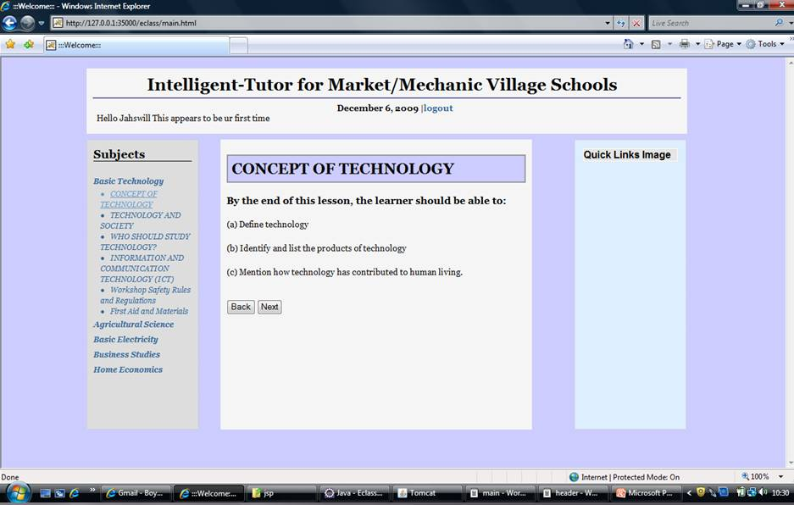
Overview of the ICT Component of the Market/Mechanic Village School contd:

Slide 9
Prospects of Market/Mechanic Village School in South Eastern Nigeria
Linking informal Apprenticeship and
formal education in Nigeria
  Open learning approach will guarantee learning for all and increased enrolment
  There will be increased interest among the apprentices on the use of ICT for studies and application of open learning principles
  Faulty Implementation could possibly ruin this laudable initiative
  There is need for stronger political will by the state governments to implement the curricula within the 2013/2014 academic year

Slide 10

Linking informal Apprenticeship and Formal Education in Africa
Conclusion and Closing Thoughts
There are lots of prospects for the use of ICT in improving informal apprenticeship in Africa
Peer learning Programme on informal Apprenticeship among African countries should be established
Development agencies should support more initiatives on informal apprenticeship transformation

