Slide 1
Sense of work-based learning and Entrepreneurship
An attempt of reflection of the relation between dual education and training and entrepreneurial competences
Michaela Marterer, & Peter Härtel
Styrian Association for Education and Economics
Johannesburg, 24 April 2013

Slide 2
Rationale, Background
Relation between innovative approaches of apprenticeship, „work-based learning“ and „entrepreneurship“ as a key element of personal competences for the world of work
Connections to real work places in general and vocational education - aspects and effects for competences, transitions and employment
Estimations of students, teachers, entrepreneurs concerning entrepreneurial knowledge, skills and attidudes

Slide 3
Research approach
Description, definitions for „Work based learning“ and „entrepreneurship“
Basic and background data concerning VET, Employment, Entrepreneurship related to the theme
Interim results of an online survey in six European countries – students, teachers, entrepreneurs concerning entrepreneurial competences
Selected comparisons, theses, further topics
Recommendations, next steps in research, programmes, practice…

Slide 4
Entrepreneurship
…enhance creativity and innovation, including entrepreneurship
  European Union, fourth long-term objective ET 2020
Entrepreneurship
Definition
Sense of initiative and entrepreneurship refers to an individual’s ability to turn ideas into action. It includes creativity, innovation and risk-taking, as well as the ability to plan and manage projects in order to achieve objectives. This supports individuals, not only in their everyday lives at home and in society, but also in the workplace in being aware of the context of their work and being able to seize opportunities, and is a foundation for more specific skills and knowledge needed by those establishing or contributing to social or commercial activity. This should include awareness of ethical values and promote good governance
Source: European Reference Framework – Key Competences for Lifelong Learning, European Communities, 2007

Slide 5
Work-based Learning
Definition 1: Acquisition of knowledge and skills through carrying out – and reflecting on – tasks in a vocational context, either at the workplace (such as alterance training) or in a VET institution.
Definition 2: programs for both secondary and post-secondary students which provide opportunities to achieve employment-related competencies in the workplace. Work-based learning is often undertaken in conjunction with classroom or related learning and may take the form of work placements, work experience, workplace mentoring, instruction in general workplace competencies and broad instruction in all aspects of industry.
Source: Naidu, R. VET Glossary, NCVER, 2008 (Rev 2011)

Slide 6
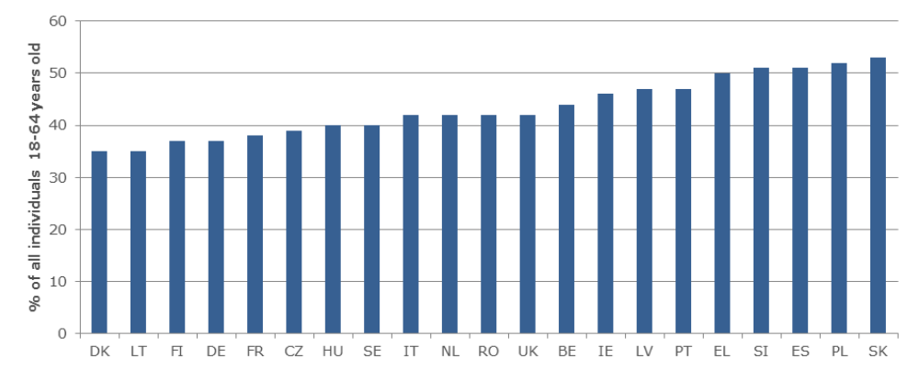
Percentage of individuals aged 18 to 64 who believe to have the required skills and knowledge to start a business in European countries, 2011
Source: Global Entrepreneurship Monitor 2011 Note: Italian result is from 2010.

Slide 7
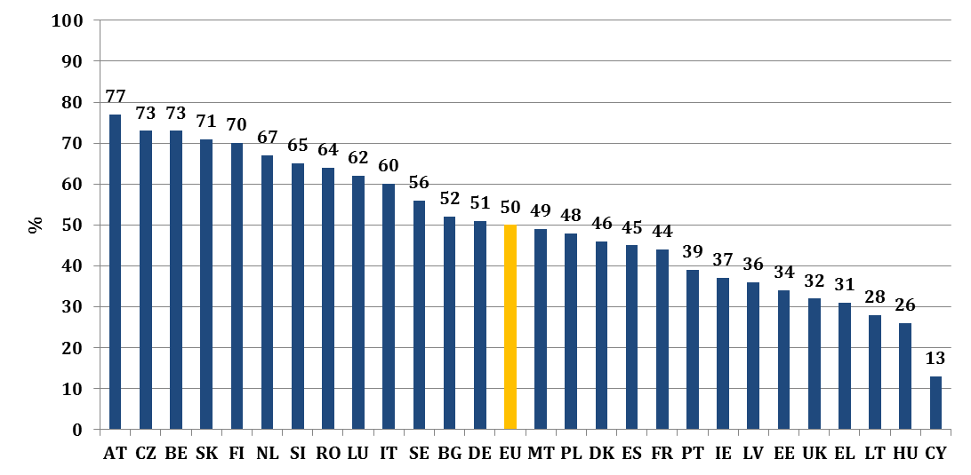
Students enrolled in vocational upper secondary education, 2010, as a % of all students enrolled in upper secondary education (ISCED level 3)
Source: Cedefop, based on data from Eurostat, UOE data collection on education systems

Slide 8
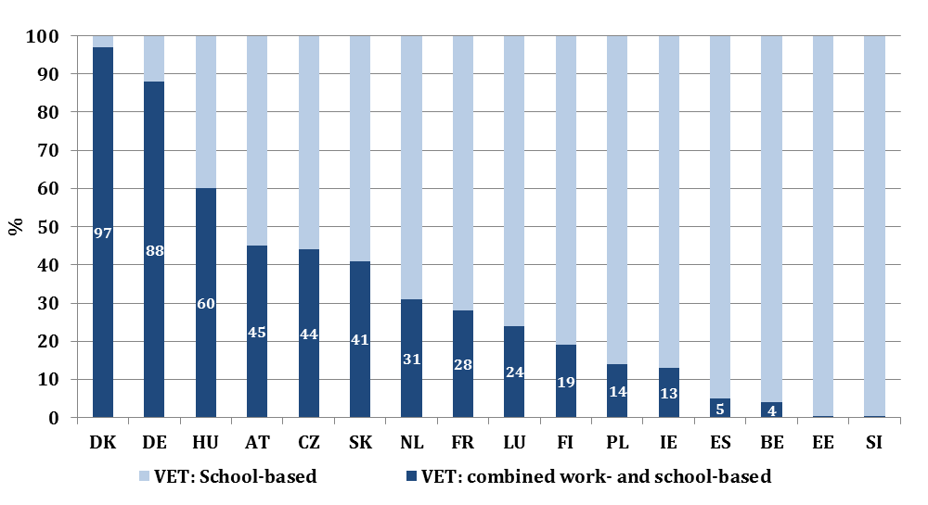
Proportion of VET students enrolled in combined work- and school-based VET, 2010, as % of all students in upper secondary VET (ISCED level 3)
Source: Cedefop, based on data from Eurostat, UOE data collection on education systems

Slide 9
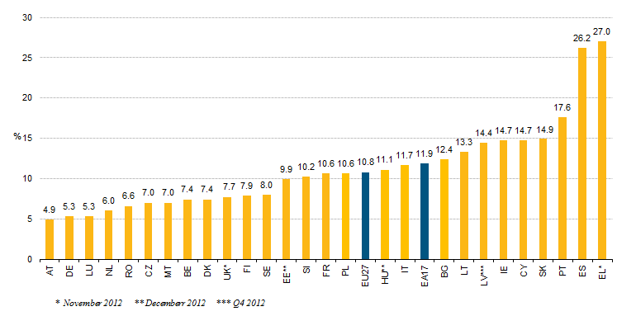
Youth Unemployment in Europe
Jugendarbeitslosigkeit Jänner 2013
Eurostat 2013

Slide 10
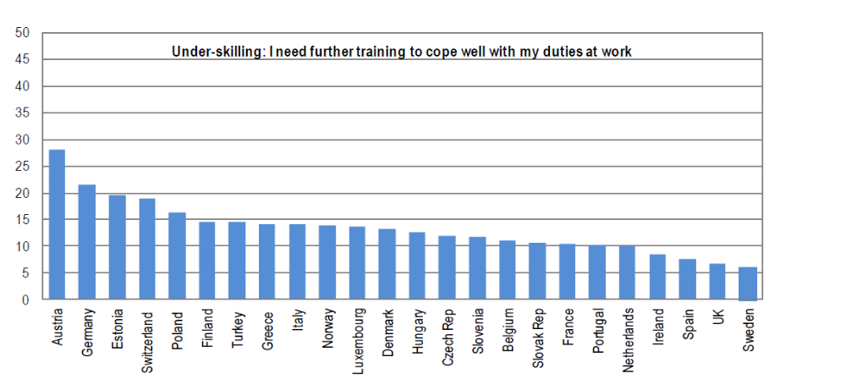
Self-reported skill mismatch
Source: Quintini, G. (2011), “Right for the Job: Over-Qualified or Under-Skilled?”, OECD Social, Employment and Migration Working Paper, No. 120, OECD Publishing, Paris.

Slide 11
Survey (Cross-Check)
Comenius Network: Entrepreneurship Education and the World of Work
9 partners of 8 countries different institutions
Survey on 25 entrepreneurial skills and abilities
With the aim to:
Compare the expectations of students, teachers and entrepreneurs within a changing world of work
Evaluate different measures at school (internal and external) concerning the outputs
Create a publication which fits for communication for raising awarness for entrepreneurial spirit and work based learning (target group = pratictionnaires - not researches)

Slide 12
Valid data within the ongonig process by 15th of April

Slide 13
Answers divided in 3 target groups

Slide 14
Country profiles e.g. Austria

Slide 15
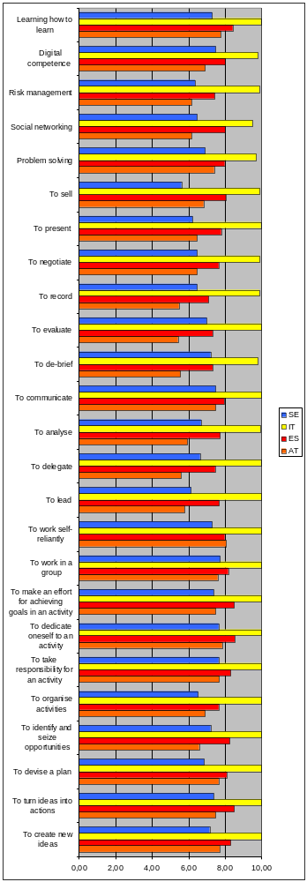
Comparison profiles e.g. AT, ES, IT, SE e.g. for Q1 /
answered by entrepreneurs

Slide 16
Related thesis:
Countries like Austria with the apprenticeship system rate this skills and abilities very low because the VET skills are more important for sucess in the working life and will be trained by the Enterprises, in their own responsibility, they do not expect the school is doing it – in comparison with Spain and Italy.

Slide 17
Ø of all answers and countries of Question 1 - all target groups

Slide 18
Ø of all answers and countries of Question 2 - all target groups: Students and Teachers

Slide 19
Ø of all answers and countries of Question 3 - target group: Teachers

Slide 20
Interpretation of results Ø to Q3:
Which of these skills and abilities can you teach yourself in your daily work?
Teachers of countries with less workbased learning principles e.g. Sweden, Spain, Italy have to fulfill more of the required skills and abilities within school.

Slide 21
Themes-Topics-Theses
AT:
  top Δ estimation importance
    Students/teachers > entrepreneurs
  Activities supporting entrepreneurial spirit
    Teachers > students
  Which of the skills could you teach by yourself
    Highest score: to work in a group
    Lowest score: Learning to learn

Slide 22
Themes-Topics-Theses
ES
  Max Δ Students < entrepreneurs
    Importance..
  Entrepreneurship activity
    Students > teachers
  What can you teach
    Highest score: Learn to learn
    Lowest score: to sell

Slide 23
Themes-Topics-Theses
SE
  Ø Δ entrepreneurs=students=teachers
  Support by activity
    Østudents = teachers
  What can you teach
    „very self-confident“ overall
  Low score SE:
    To delegate
    To sell
  But: on a higher level..

Slide 24
Premises, Promises, Pitfalls…
Estimations in school, by students and teachers – and by entrepreneurs – at a base for real working approaches – are deeply founded by approaches of cultural aspects of education, VET, and entrepreneurship
The culture of „ownership“ for the next generation of skilled – and „occupational minded“ in enterprises and „guilds“
Depending on that: expectations and demands to the state to create all relevant skills and competences…

