Slide 1


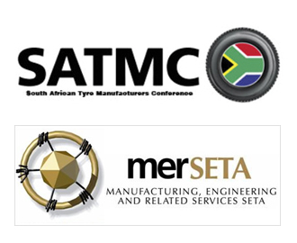
Unpacking Automotive Components Manufacturing SIC codes and activities of mer sector companies for sectoral profiling to assess and understand industry readiness for the 4th industrial revolution
Prof Hoosen Rasool
04 May 2022

Slide 2
  Background
Identify ACM technological changes
Identify the skills needs of ACM firms and employees
Recommend priority skills development interventions
Assess ACM skills readiness for 4IR
Define automotive components manufacturing
Review SIC code allocations in 6 chambers

Slide 3
  Structure
Section One | About the Sector: Introduction
Section Two | Sector Profile: Profile of the Sector
Section Three | Literature Review: Advancing Technologies
Section Four | Skills Development: Sector Skills Challenges
Section Five | Findings and Recommendations

Slide 4
  Definition
ACM is the production of parts used to assemble a vehicle (before market) and the vehicle's service (aftermarket). ACM firms manufacture and fabricate according to specific motor vehicle industry specifications for OEMs, first or second-tier manufacturers in the value chain.
Definition
38200 - Manufacture and repairs of bodies (coachwork) for motor vehicles; manufacture of trailers and semi-trailers
38300 - Manufacture and repair of parts and accessories for motor vehicles and their engines
38710 - Manufacture and repair of motorcycles
SIC Codes

Slide 5
  SIC Code Findings
Chambers | Firms
Tyre | 97
Plastics | 110
Metals | 1 322
Auto Manufacturing | 59
ACM | 298
Motor Retail | 2 552
No Allocation | 7 777
ACM Chamber | Firms
Firms that should be in ACM | 424
383300 (parts manufacturing) | 205
383200 (body repairs/panel beating) | 231
+126 companies
ACM Chamber SIC code status quo remain (SIC codes 38200, 38300 and 38710).
Primary goals are to upskill the workforce and improve firm-level competitiveness.
The Chamber should not be distracted by technical definitions of the scope of industrial coverage or SIC codes.
114 firms submitted WSPs.

Slide 6
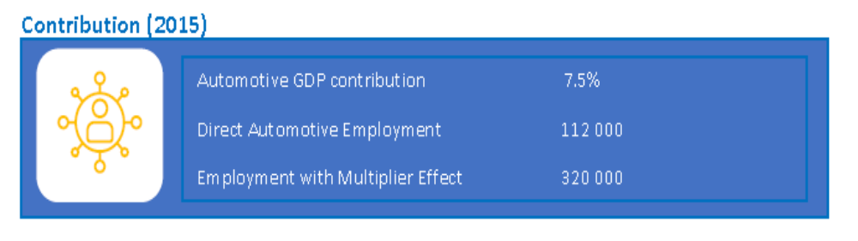
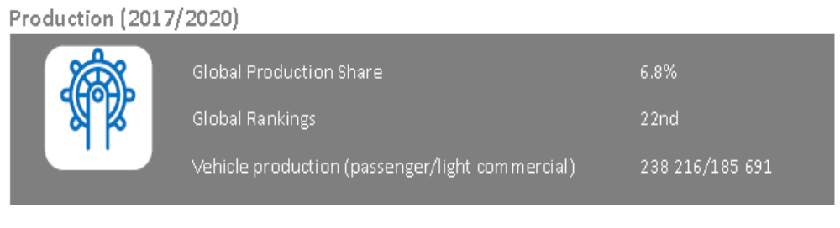
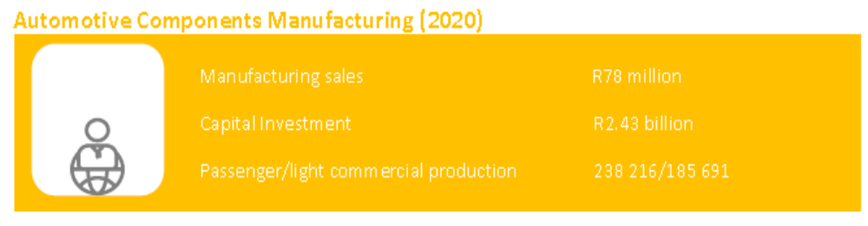
  Economic Profile

Slide 7
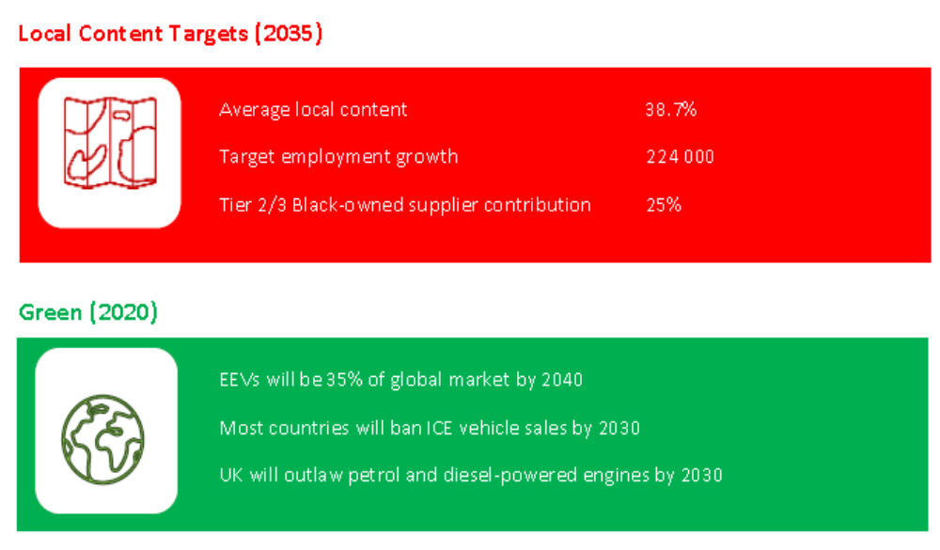
  BACKGROUND

Slide 8
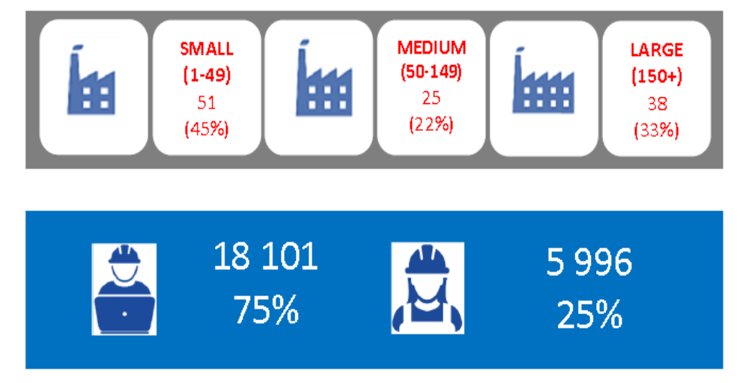
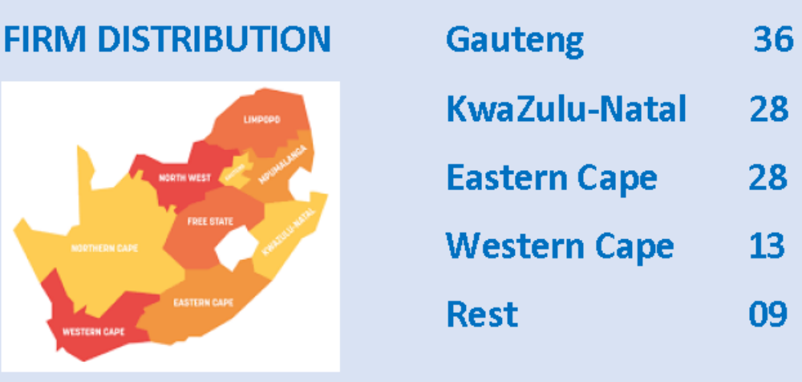
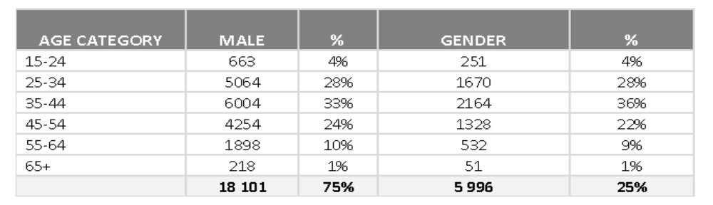
  Labour market Profile

Slide 9
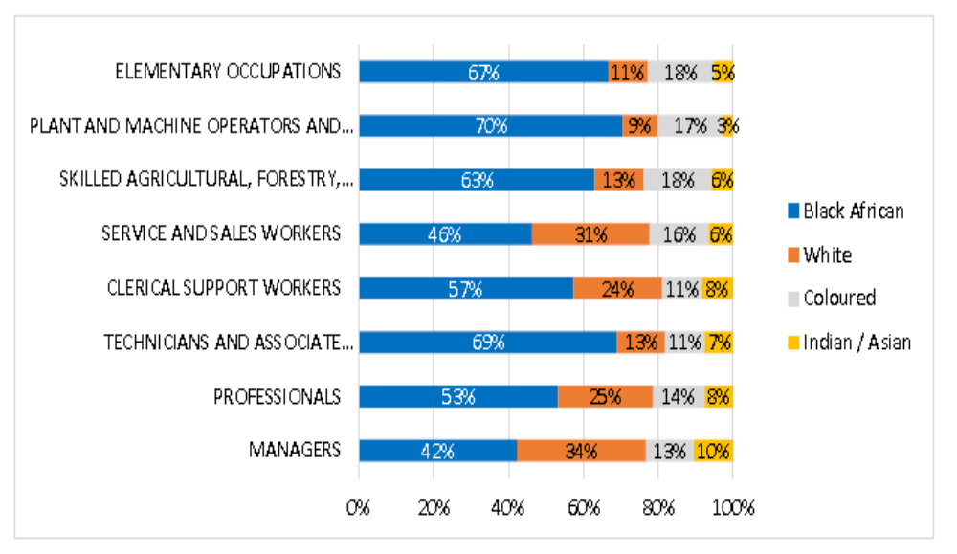
  Labour market Profile

Slide 10
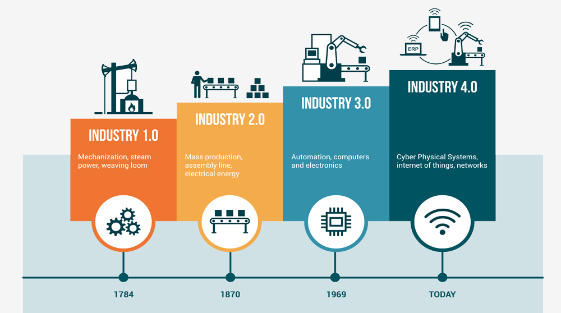
  4IR Misconceptions
Technological advancements does not occur in discrete stages
Robots and automation have been used in manufacturing since Industry 1.0.
Internet of things, simulation, automation, machine learning continuation from Industry 3.0
Digital technologies that gave rise to "Industry 4.0" are advancements from Industry 1.0, 2.0 and 3.0.
Prefer term "advancing technologies"
Industry expert remarked, "I have looked at my work plant. There is nothing significantly new from 20 years ago."

Slide 11
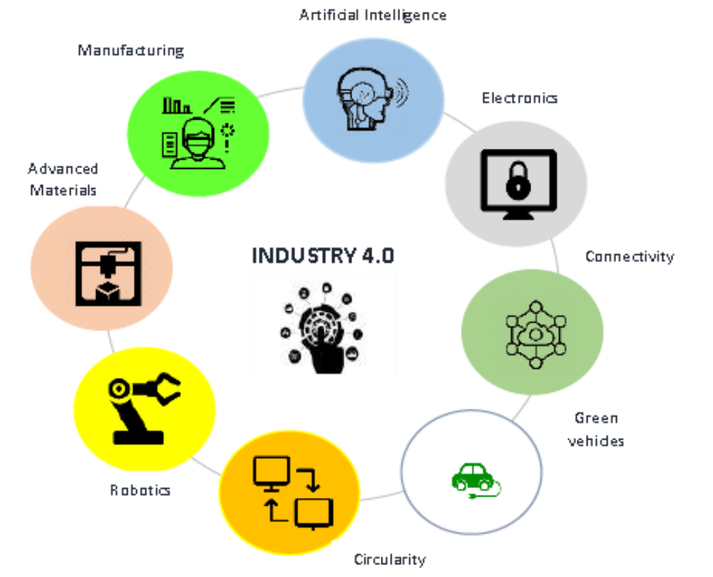
  4IR Elements
Technology Advancements
Artificial Intelligence
Electronics
Connectivity
Automation & Robotics
Manufacturing Processes
Advanced Materials
Green Vehicles
Alternative Fuels
Circularity

Slide 12
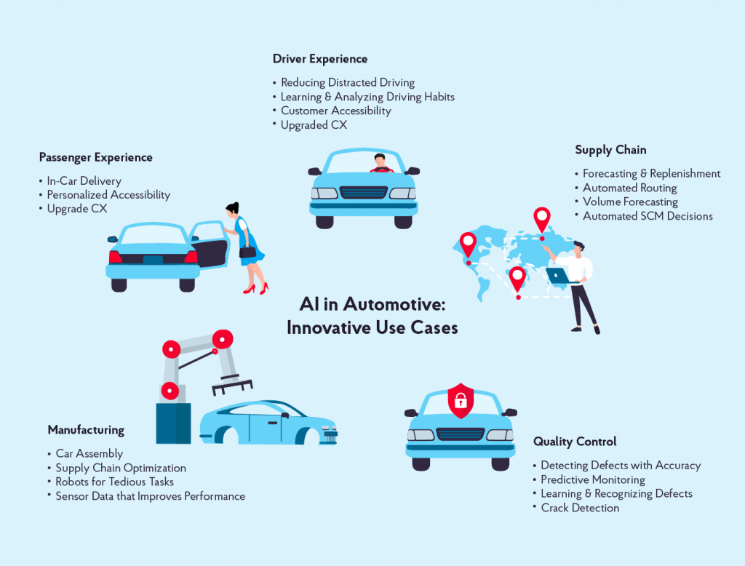
  AI

Slide 13
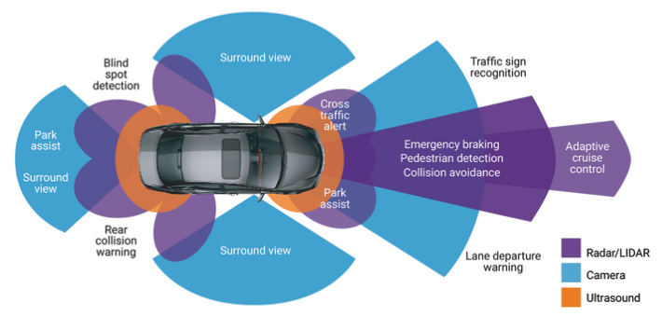
  Electronics

Slide 14
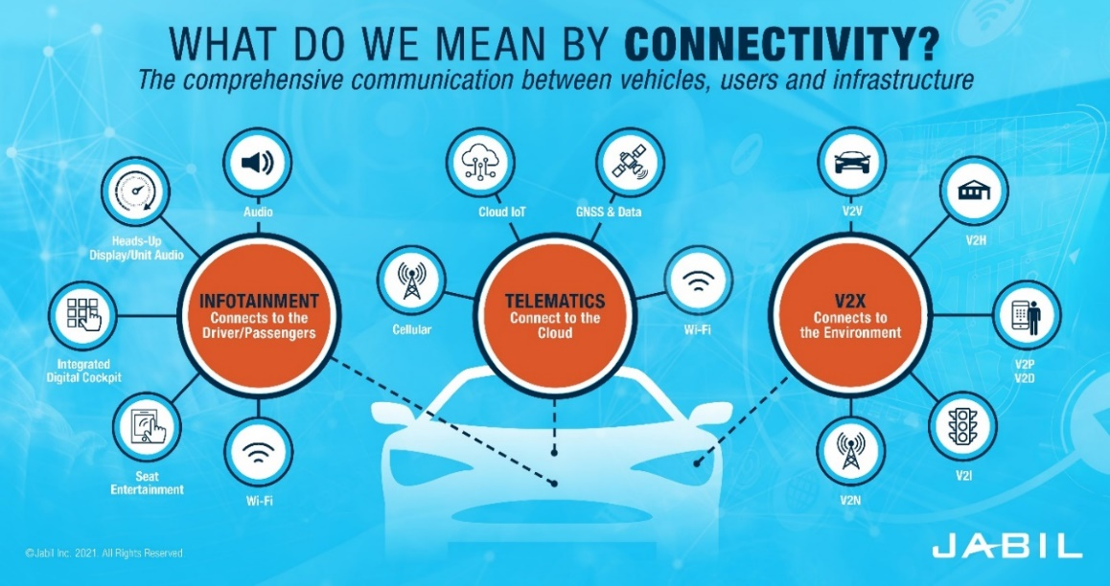
  Connectivity

Slide 15
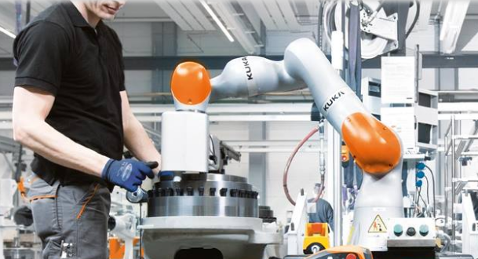
  Robotics / Automation
3D Printing – Advanced welding techniques are used to weld components. 3D Printing reduces this need. Solid components can be formed over a short period.
Robotics – Robots are used to perform tedious, risky tasks. With advanced technologies, robots work with humans as 'cobots'.
IoT – IoT is instrumental in digital transformation and data-driven process automation and optimisation. IoT-enabled digital transformation connects machines.

Slide 16

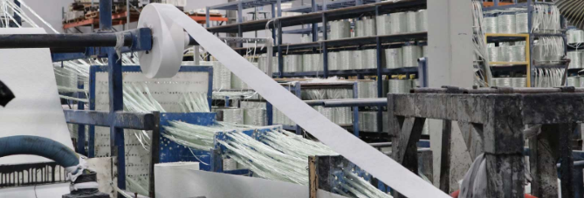
  Advanced Manufacturing
Smart factories (SFs) leverage digital technologies to enhance productivity, feasibility, quality and service.
The objective is for SF is self-optimisation in operations.
SF constantly adapts to supply/demand variations and process deviations.
These factories depend on three critical technologies for their operation.
Connectivity – IIoT is used for data collection from sensors
Intelligent automation – the use of advanced robotics
Data analytics – the use of cloud-scale data management to implement predictive analytics.

Slide 17
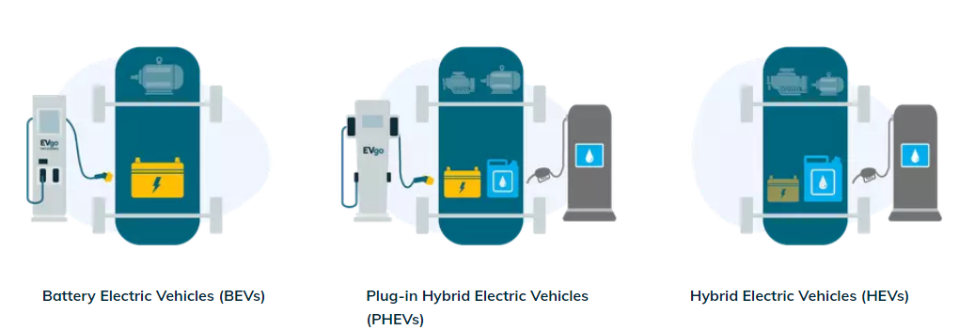
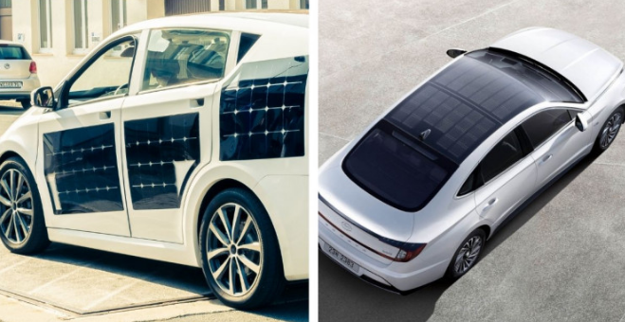
  Green Vehicles

Slide 18
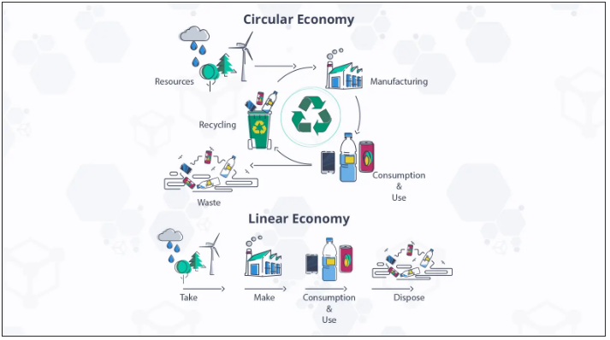
  Circularity

Slide 19
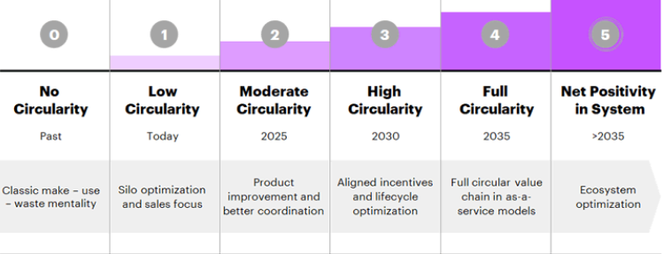
  Circularity

Slide 20
  Recommendations
TRANSFORM MASTERPLAN INTO AN ACTION PLAN Transform the Masterplan skills development statements into actionable programmes adopting SMART (specific, measurable, achievable, realistic, timebound) with a value chain approach. Establish an implementation structure with financial and human resources to manage the skills development programmes of the Masterplan. Ensure that programmes address the training, beneficiaries, timelines, targets, funding, training providers, etc. Engage MERSETA to ensure that the mandatory and discretionary skills development grants align with the Masterplan skills development priorities.

Slide 21
  Recommendations
IMPROVE THE TRAINING RATE Improve the employee training rate in the sector. Conduct employee training needs surveys and feedback sessions on current skills supply, demand and mismatches. Investigate different training and education modalities that can be implemented in the firm. Survey the industry to understand the current, ongoing, and relevant skills challenges to ensure that future focus and funding are directed towards the highest priority skills sector needs.

Slide 22
  Recommendations
FOCUS ON SKILLS DEVELOPMENT Keep the Chamber focused on the following: Improving the training and graduate rates of the workforce. Making training accessible for the workforce (those that need and want training should be trained) Ensuring that training is responsive to employer demand. Maintain the ACM Chamber SIC code status quo (SIC codes 38200, 38300 and 38710).

Slide 23
  Training
A Decent Work Survey was conducted by Mashilo, covering 184 workers in 16 automotive components firms in the Gauteng Province. The survey found the following:
36.4% of workers never attended work-related training after receiving the necessary training to perform the jobs.
14.7% of workers attended training in the last five years.
7.6% of workers attended training more than five years ago.
41.3% of workers attended training in the last 12 months.
Workers, on average, spent eleven working days in training.
Mashilo concludes that while firms were pursuing continuous improvement strategies, the same could not be said about skills training, especially training that leads to nationally recognised qualifications.
In 2015, out of a workforce of 82 100, 289 graduated at NQF Level 2 and 69 at NQF level 3. These graduate numbers are significant since 74% of the automotive components manufacturing sector is at the operator level. Ibid.

Slide 24
  Recommendations
ADOPT FLEXIBLE TRAINING MODALITIES MERSETA is making progress into adopting flexible learning modalities: Digitisation of whole or part qualifications - Solar Photovoltaic Technician Digitisation of technical concepts - Augmented reality or virtual reality (AR-VR) capabilities Digital academy - online hosting of courses with live teachers or experts

Slide 25
  Recommendations
ADOPT FLEXIBLE TRAINING MODALITIES MERSETA is making progress into adopting flexible learning modalities: Digitisation of whole or part qualifications - Solar Photovoltaic Technician Digitisation of technical concepts - Augmented reality or virtual reality (AR-VR) capabilities Digital academy - online hosting of courses with live teachers or experts

Slide 26
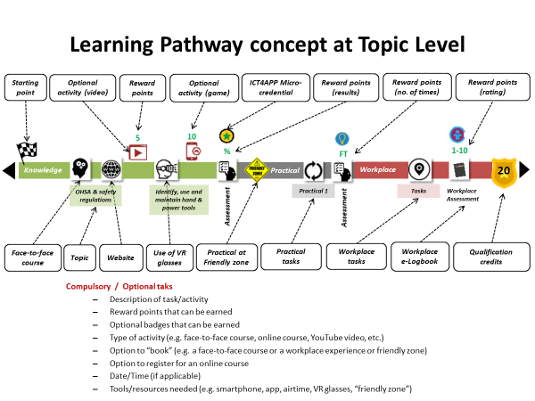
  Recommendations

Slide 27
  Recommendations
ADOPT FLEXIBLE TRAINING MODALITIES Recognise and incentivise other non-formal and informal learning forms to reskill, upskill, and increase the training rate. Encourage different learning delivery modalities such as full-time, part-time, correspondence, e-learning, micro-learning leading to digital credentialing, and blended learning. Conduct a feasibility study of how micro-learning and digital credentialing can fit into the training mix. Develop an ACM innovation project on flexible learning modalities. The MERSETA digitisation initiatives should be implemented as an actionable programme to provide employees with greater training access.

Slide 28
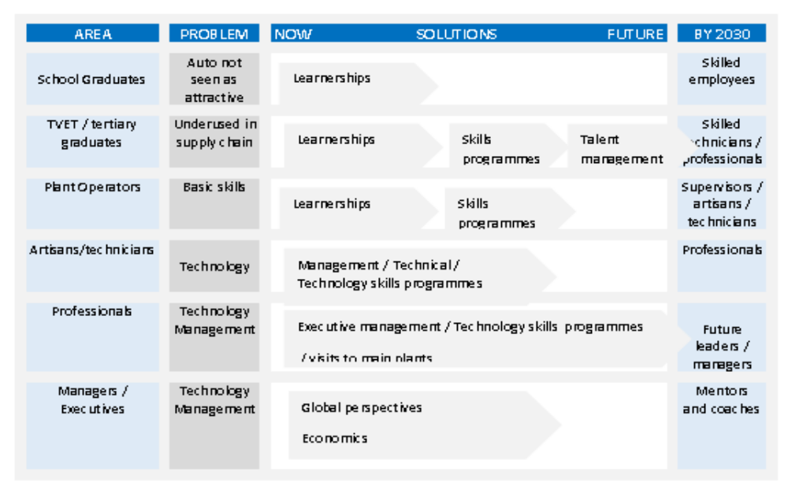
  Recommendations
MAKE AUTOMOTIVE ATTRACTIVE TO TALENTED YOUTH

Slide 29
  Recommendations
THINK DIGITALISATION Assess the digital maturity level of individual firms. Develop a digital transformation strategy focusing on infrastructure, skills development, data analytics and implementation. Invest in "tech-savvy" (younger) talent and leverage the knowledge of the legacy workforce to fit digital technologies into the production system. Capacitate employees with basic, intermediate and advanced data analytics courses.

Slide 30
  Conclusion
In response to the question of whether the automotive components manufacturing sector is ready for Industry 4.0, the following should be noted:
ACM firms respond to the OEMs’ current product and service needs per vendor specifications.
ACM firms cannot retool for future products and services that they do not know. The OEMs will specify what is required, when and in what volumes. ACM firms respond to client demand.
No firm can reasonably aspire to adopt a state-of-the-art infrastructure because "state-of-the-art" is sure to advance by some degree when new infrastructure is installed.

Slide 31
  Conclusion
The future of automotive components manufacturing is likely to be the digitalisation of manufacturing processes.
The best that firms can do is prepare the workforce with entry, intermediate and advanced digital skills to anticipate product and service innovation.
Digitalisation is not and cannot replace mechanical processes. It should not be viewed as a discrete process divorced from mechanics. It simply optimises mechanisation.
There is a good reason to pursue digitalisation. Data is becoming as valuable as the product. Currently, the value of data is yet to be realised in local firms.
The adoption of digitalisation in manufacturing is a journey and a continual improvement process. It is not a singular event.
ACM firms should assess its digital maturity level and devise a digital transformation strategy to achieve its goals.

Slide 32

Thank you
Prof Hoosen Rasool
+27 83 786 9329
+27 11 064 1600
hoosen@frresearch.co.za
www.frresearch.co.za

