Slide 1



Gender-Based Violence in the Metal and Engineering Industry
21 February
Prof Hoosen Rasool

Slide 2
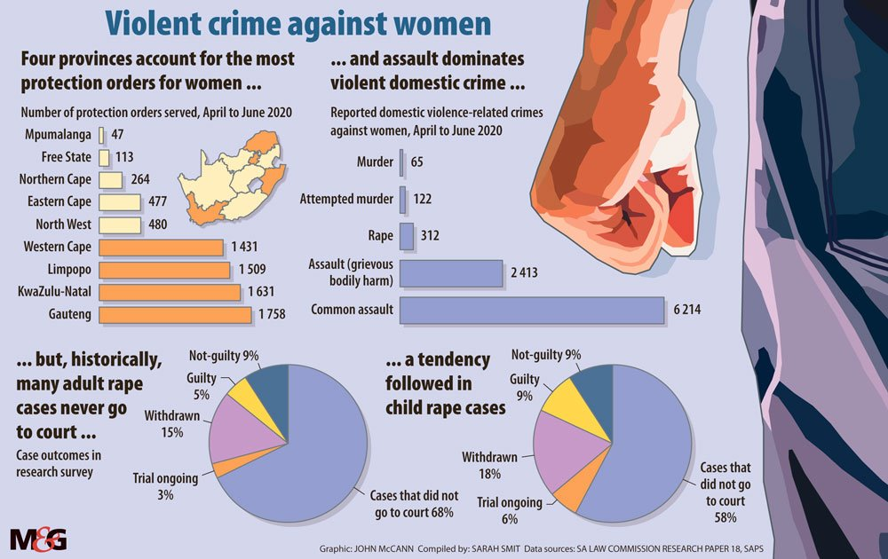

  BACKGROUND

Slide 3
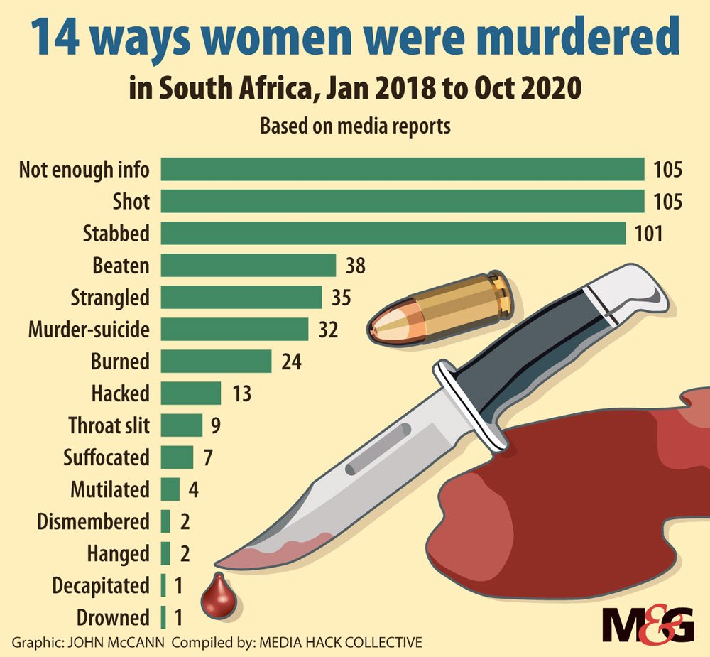
  BACKGROUND

Slide 4
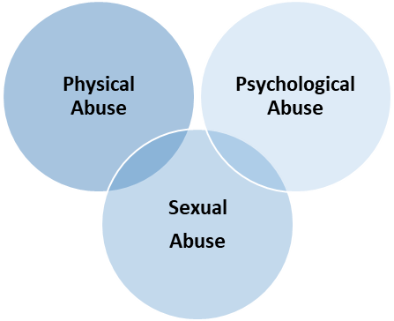
  GBV DEFINITION
BACKGROUND
Social and verbal abuse
Physical attacks and fights
Corporal punishment
Destroying property
Bullying
Sexual Harassment
Coercion
Unwanted sexual touching
Rape and attempted rape
Sexual comments and jokes
Gender-based discrimination

Slide 5
  RESEARCH METHODS
Literature review | Conference papers, journals, seminars, periodicals, GBV publications of GBV. No publications of GBV in metal industry
Interviews | 17 HR Managers and 4 GBV victims in metal industry
Firm Survey | A 103 responses were received

Slide 6
  BACKGROUND
Employment Equity Act 55 of 1998
Maintenance Act No. 99 of 1998
Domestic Violence Act No 116 of 1998
Children’s Act 38 of 2005
Criminal Law (Sexual Offences and Related Matters) Amendment Act of 2007
Code of Good Practice on the Handling of Sexual Harassment in the Workplace (2008)
Protection from Harassment Act 17 of 2011
Prevention and Combating of Trafficking in Persons Act 7 of 2013

Slide 7
  BACKGROUND
 | Work-Related Impact
98% | Difficulty concentrating at work
96% | Affected their ability to perform job duties
87% | Received abusive phone calls at work; approximately 50 – 100 call p/w
78% | Abuser showed up at work
13% | Being assaulted at work by domestic abuser
78% | Being late for work due to domestic abuse
77% | Arriving late to work due to the abuser keeping them up late or all night
47% | Assaulted before going to work
60% | Losing jobs due to being fired or resignation
45% | Scared of losing their jobs if employer found out about their abuse
23% | Abuser violated protection orders by contacting victim at work
5% | Employer had a domestic violence policy in place

Slide 8
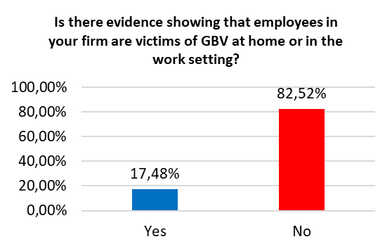
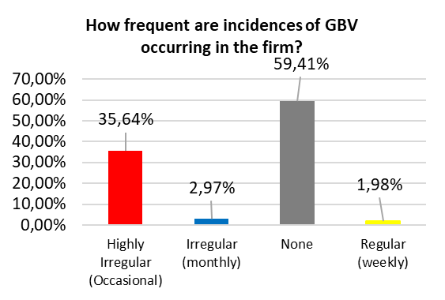
  SURVEY FINDINGS

Slide 9
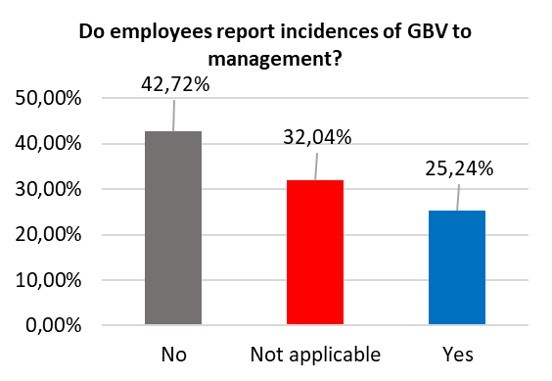
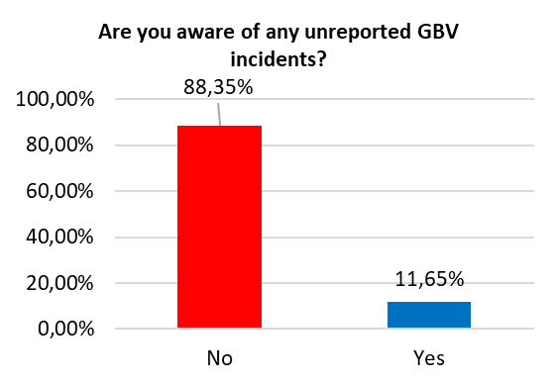
  SURVEY FINDINGS

Slide 10
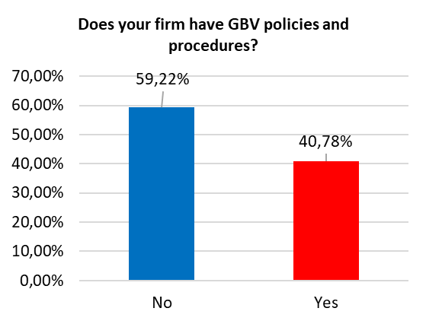
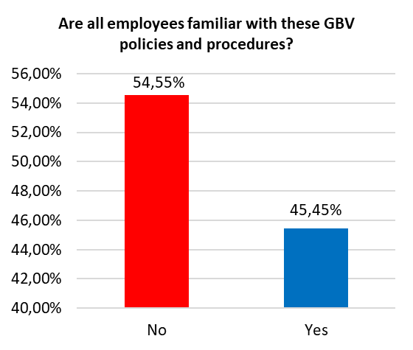
  SURVEY FINDINGS

Slide 11
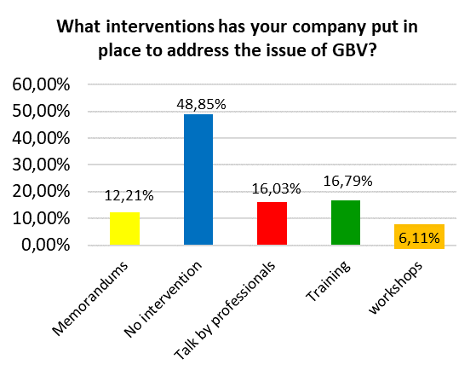
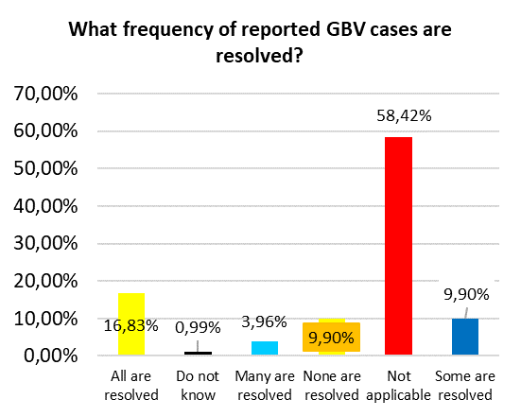
  SURVEY FINDINGS

Slide 12
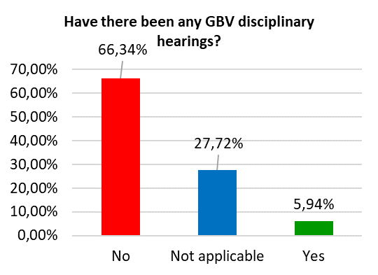
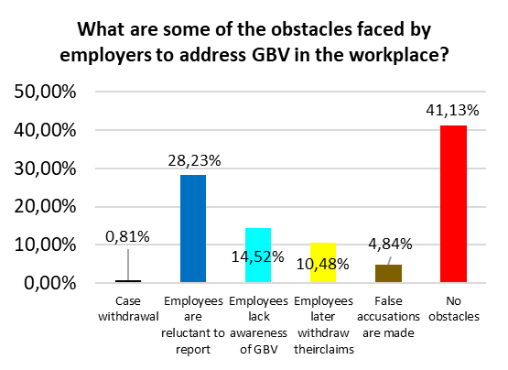
  SURVEY FINDINGS

Slide 13
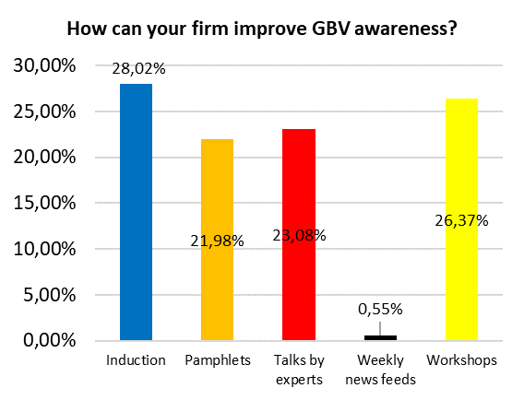
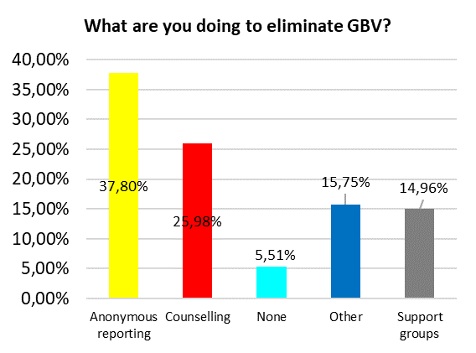
  SURVEY FINDINGS

Slide 14
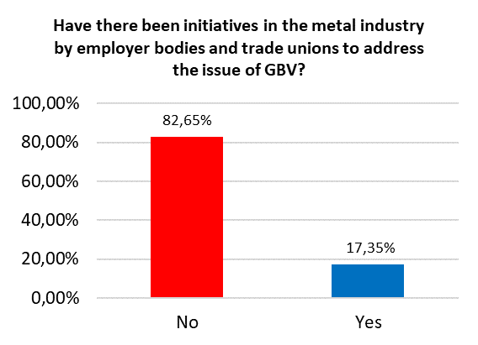
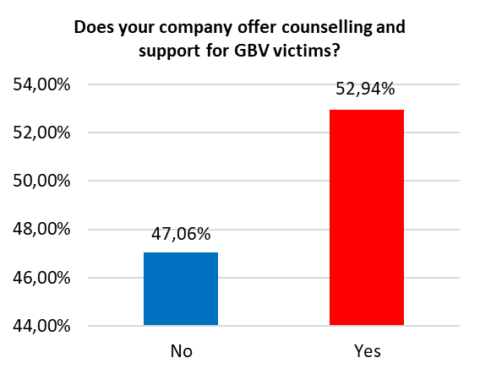
  SURVEY FINDINGS

Slide 15
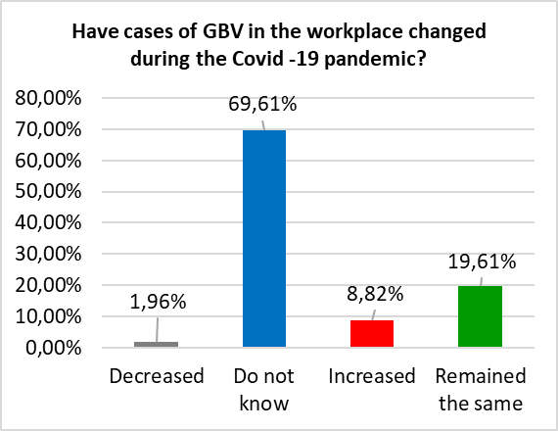
  SURVEY FINDINGS

Slide 16
  RECOMMENDATIONS
Industry Awareness Develop an industry strategy and plan to highlight GBV and support its victims. Lobby individual firms to conduct education and awareness programmes for employees. Put GBV on the agenda for industry conferences and seminars. Develop industry-wide policy guidelines of how individual companies should address GBV. Employer bodies and trade unions should support the elimination of GBV in its constituencies through programmes.

Slide 17
  RECOMMENDATIONS
GBV Costs The industry stakeholders should start a process of calculating and costing the impact of GBV on the industry.
Community Support community-based initiatives to prevent violence, including school-based programmes, to address gender norms and attitudes, and mobilising individuals and communities to challenge these social norms. Provide support to community-based NGOs that deal with GBV and that aid victims of GBV.

Slide 18
  RECOMMENDATIONS
Victim support The merSETA should develop education and training programmes on what is GBV, how it affects victims, and what assistance victims need. Companies, trade unions and employer bodies should run training programmes for employees on GBV to show how victims and abusers can seek help and learn to relate in a healthy way. Conduct specialist training for HR and the Wellness/Nursing staff to deal with GBV and sexual harassment. Provide education, training, and dialogue on how employees (both women and men) can access community-based counselling to assist their partners deal with substance abuse and addictive behaviour.

Slide 19
  RECOMMENDATIONS
Company-level Interventions Companies should develop GBV policies and procedures. GBV issues should be communicated to employees. Employees should be given training on GBV. Management should be trained to identify GBV victims and aid them. GBV victims should have access to professional counselling. Posters and information leaflets developed. GBV should be part of any EAP that the company has in place. Consider developing the “Safe Circle” approach. This approach has been used by companies such as Ford, Lockheed, and Rolls Royce. This approach involves management and employees meeting in small groups in order to increase communication between supervisors and workers over issues such as GBV and sexual harassment. Alternatively consider appointing a GBV representative, similar to a Health and Safety officer, who is trained in dealing with employees facing GBV. Consider getting the SAPS to regularly visit the company to explain to employees how they can use the Domestic Violence and Sexual Offenses Acts to assist victims of GBV.

Slide 20
  BACKGROUND
Abusers The company should include rehabilitation and assistance to abusers as well as conduct an awareness campaign targeting abusers that are in the employment of the company. Allow for victims to have access to affordable medical/psychological assistance.

Slide 21
  RECOMMENDATIONS
Support Emergency telephone numbers should be easily accessible to GBV victims. Details of support structures in the community, such NGOs, safe houses, and religious organisations should be accessible to GBV victims. GBV survivors should be educated on how to obtain protection orders against a violent or threatening person. GBV survivors should be educated on the psychological effects GBV can have on them and understand the importance of seeking counselling or similar assistance. GBV survivors should understand that the abuse can affect their behaviour and may result in the victims resorting to drugs and alcohol as a survival mechanism. They also need to understand that they can extend that violence to their children without realising that their actions are effects of the GBV they are facing. GBV should learn to recognise what is going on in their relationship and seek the necessary help and assistance. GBV survivors should recognise when their abusive partners blame them for the abuse and understand that this is not the truth, but rather a manipulative strategy used by perpetrators.

Slide 22
Thank you
Prof Hoosen Rasool
+27 83 786 9329
+27 11 064 1600
hoosen@frresearch.co.za
www.frresearch.co.za

